Slide 1
Streaming algorithms for edit distance
Michal Koucký
Charles U., Prague
Joint work with:
Diptarka Chakraborty
Charles U., Prague
Elazar Goldenberg
The Academic College of Tel Aviv-Yaffo

Slide 2

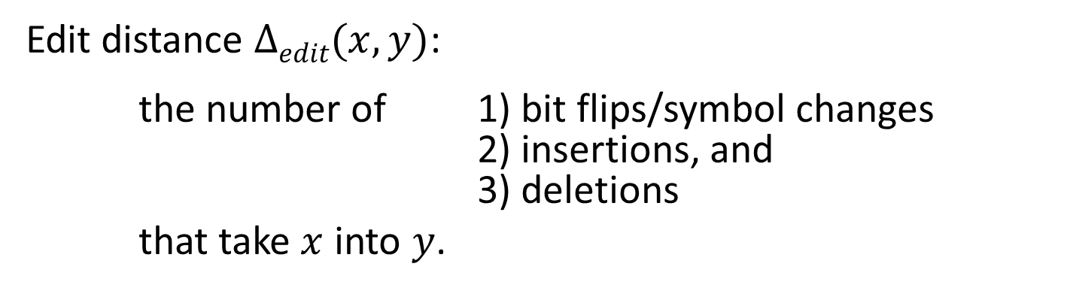

Edit distance
$$x$$
a
b
c
z
d
e
f
w
h
i
k
l
m
$$y$$
a
b
c
d
e
f
g
h
i
j
k
l
m
Edit distance $Δedit(x,y)$:
the number of 1) bit flips/symbol changes
2) insertions, and
3) deletions
that take $x$ into $y$.

Slide 3
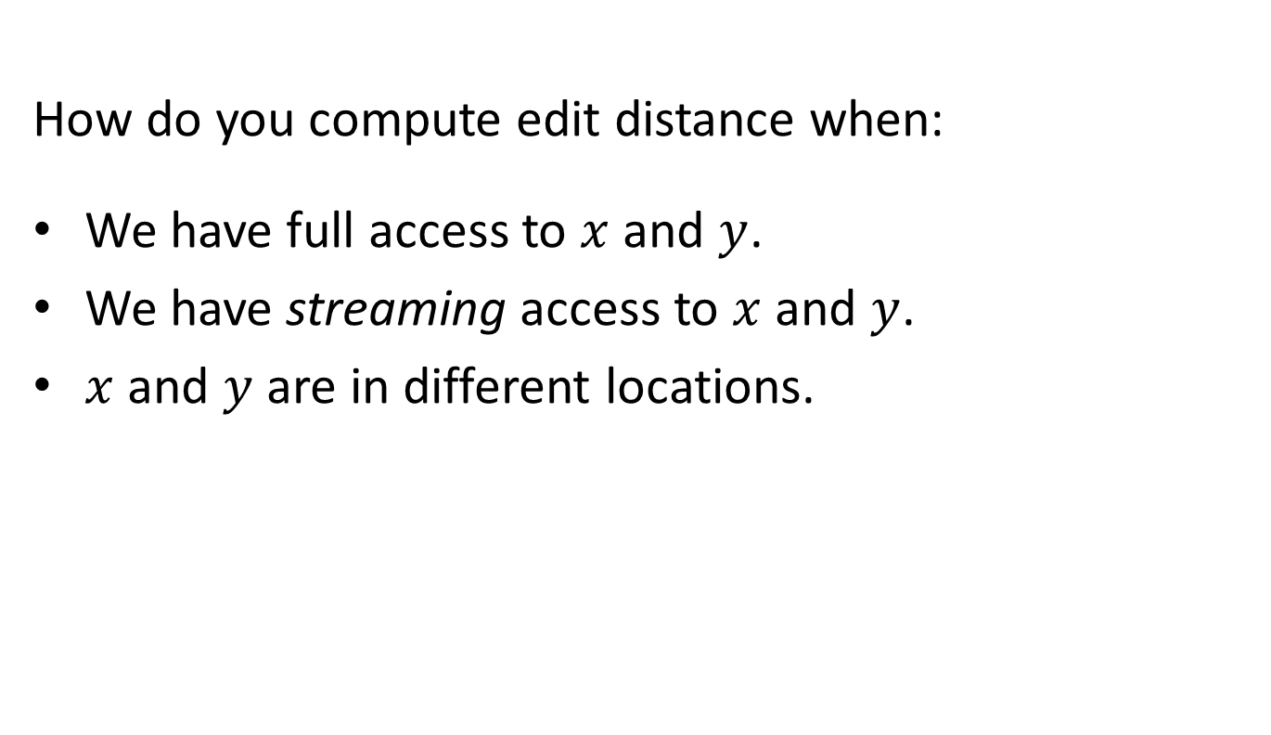
Main question
How do you compute edit distance when:
We have full access to $x$ and $y$.
We have streaming access to $x$ and $y$.
$x$ and $y$ are in different locations.

Slide 4
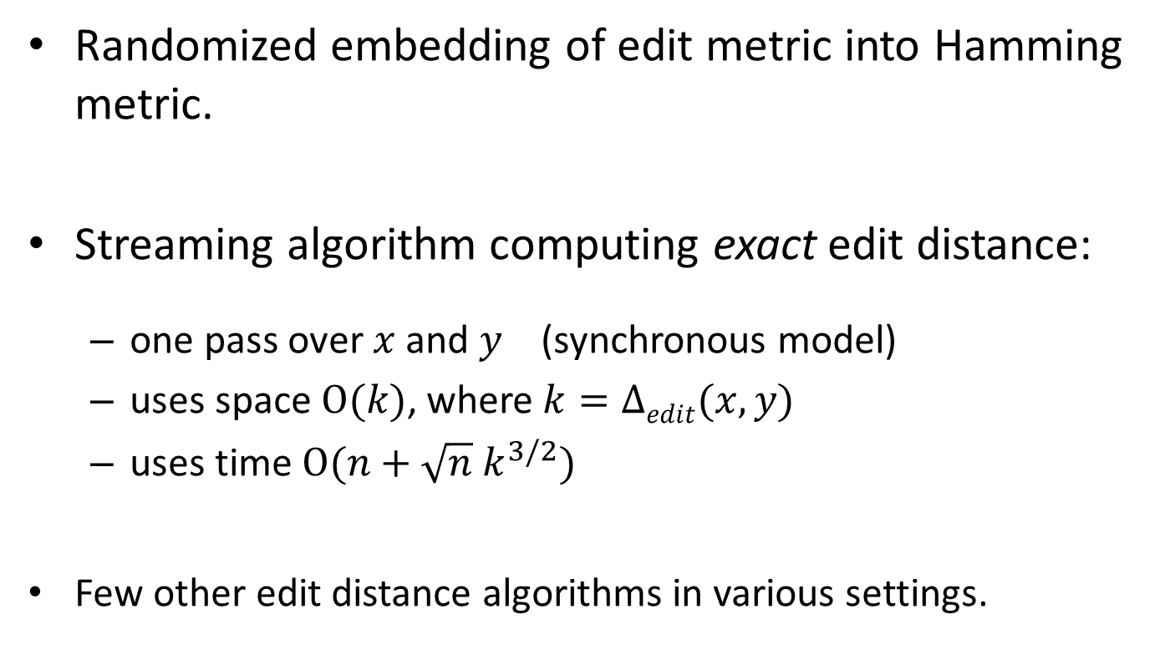
Our results
Randomized embedding of edit metric into Hamming metric.
Streaming algorithm computing exact edit distance:
  one pass over $x$ and $y$ (synchronous model)
  uses space $O(k)$, where$k=Δedit(x,y)$
  uses time $O(n+\sqrt{n} k^{3/2})$
Few other edit distance algorithms in various settings.

Slide 5
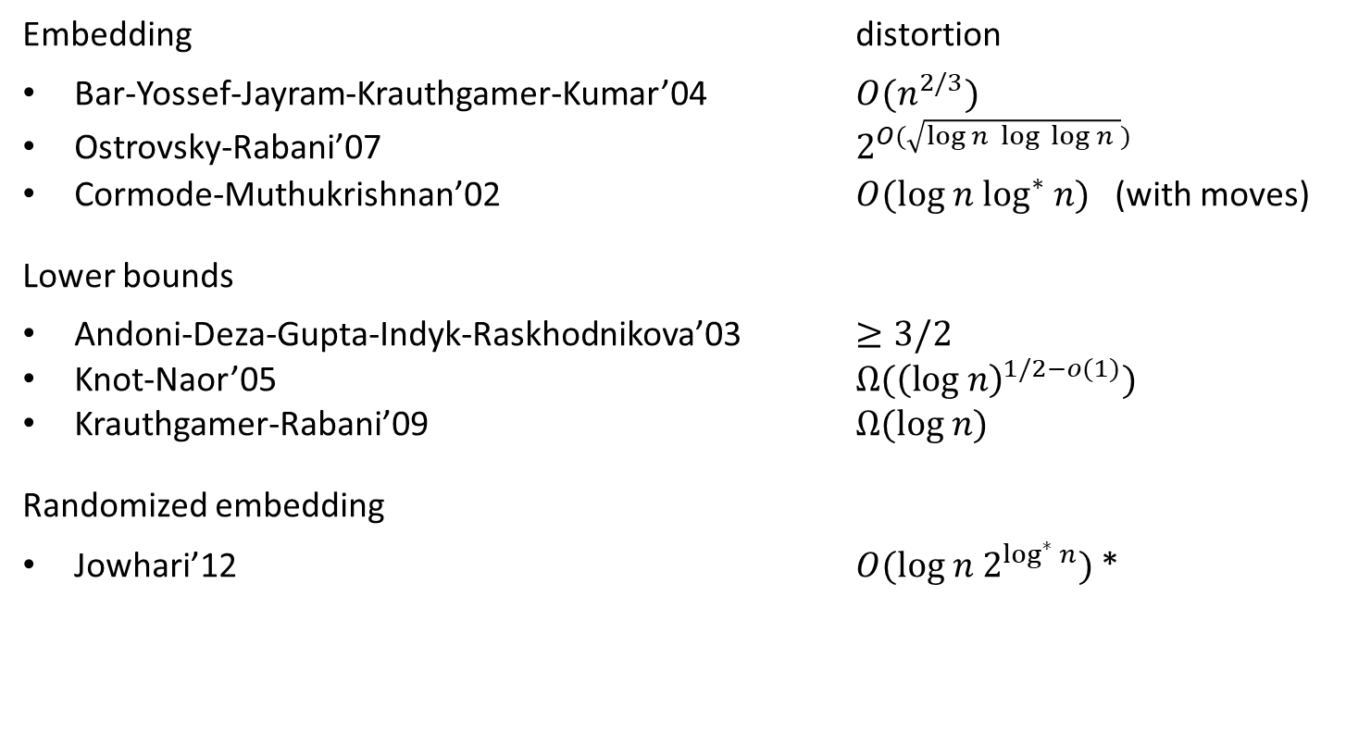

Embedding edit into $ℓ_{1}$ distance
Embedding distortion
Bar-Yossef-Jayram-Krauthgamer-Kumar’04 $O(n^{2/3})$
Ostrovsky-Rabani’07 $2^{O(\sqrt{log n log log n })}$
Cormode-Muthukrishnan’02 $O(log n \log^{∗} n)$ (with moves)
Lower bounds
Andoni-Deza-Gupta-Indyk-Raskhodnikova’03 $≥3/2$
Knot-Naor’05 $Ω({\left(log n\right)}^{1/2−o(1)})$
Krauthgamer-Rabani’09 $Ω(log n)$
Randomized embedding
Jowhari’12 $O(log n 2^{\log^{∗} n})$*

Slide 6
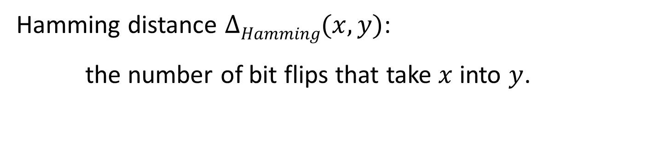
Hamming distance
$$x$$
a
b
c
z
d
e
f
i
j
k
l
m
n
$$y$$
a
b
c
d
e
f
z
i
j
k
l
m
n
Hamming distance $ΔHamming(x,y)$:
the number of bit flips that take $x$ into $y$.

Slide 7
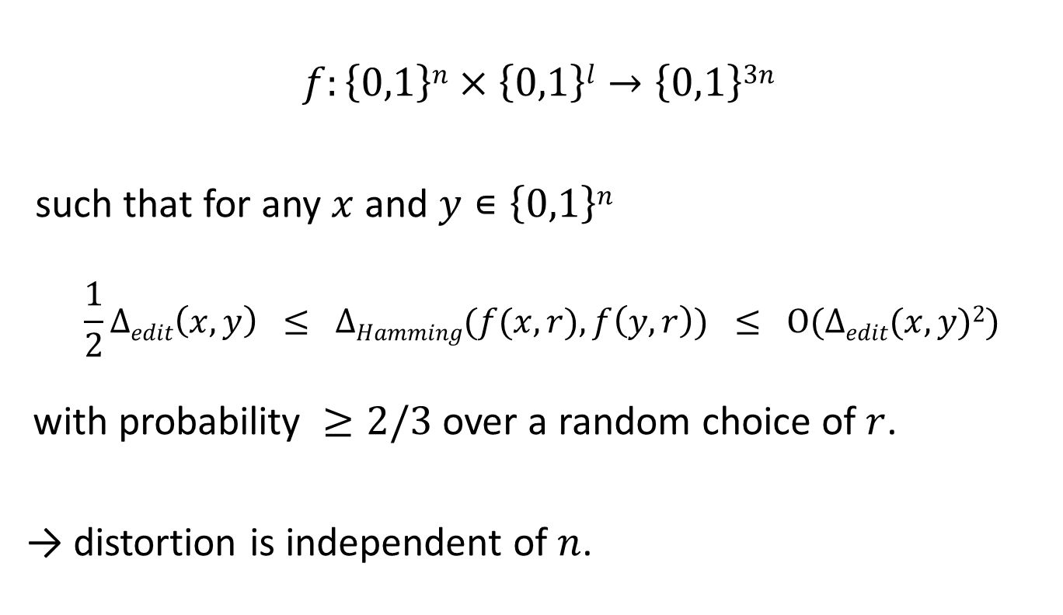
Randomized embedding of edit distance → Hamming distance
$$f:\left\{0,1\right\}n×\left\{0,1\right\}l→\left\{0,1\right\}3n$$
such that for any $x$ and $y∊\left\{0,1\right\}n$
  $$\frac{1}{2}Δedit\left(x,y\right) ≤ ΔHamming(f(x,r),f\left(y,r\right)) ≤ O(Δedit(x,y)2)$$
with probability $≥2/3$ over a random choice of $r$.
→ distortion is independent of $n$.

Slide 8
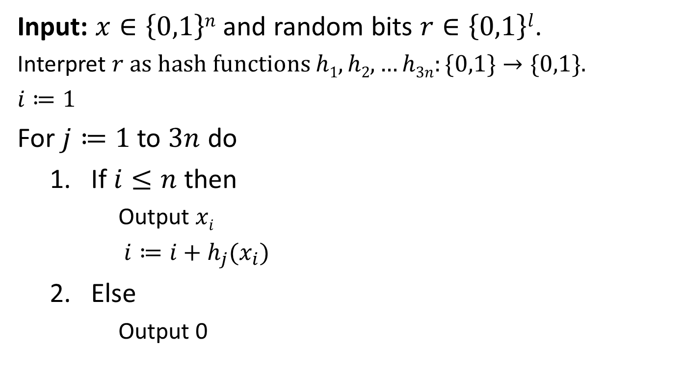
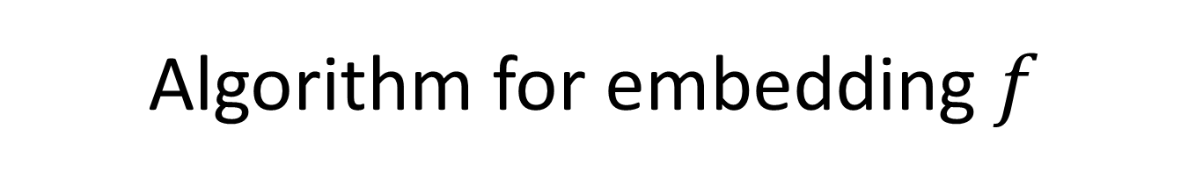

Algorithm for embedding $f$
Input: $x∈\left\{0,1\right\}n$ and random bits $r∈\left\{0,1\right\}l$.
Interpret $r$ as hash functions $h1,h2, …h3n:\{0,1\}→\{0,1\}$.
$i≔1$
For $j≔1$to $3n$ do
  If $i≤n$then
      Output $xi$
      $i≔i+h_{j}(x_{i})$
  Else
      Output 0
$$x$$
0
1
0
0
1
0
1
0
0
1
1
1
0
0
0
1
0
0
1
1

Slide 9

Why it works
$$x$$
a
b
c
z
d
e
f
g
h
i
k
l
m
a
a
b
c
c
z
z
d
d
e
f
l
m
…
a
a
b
c
c
d
e
e
f
f
f
l
m
…
$$y$$
a
b
c
d
e
f
g
h
i
j
k
l
m

Slide 10
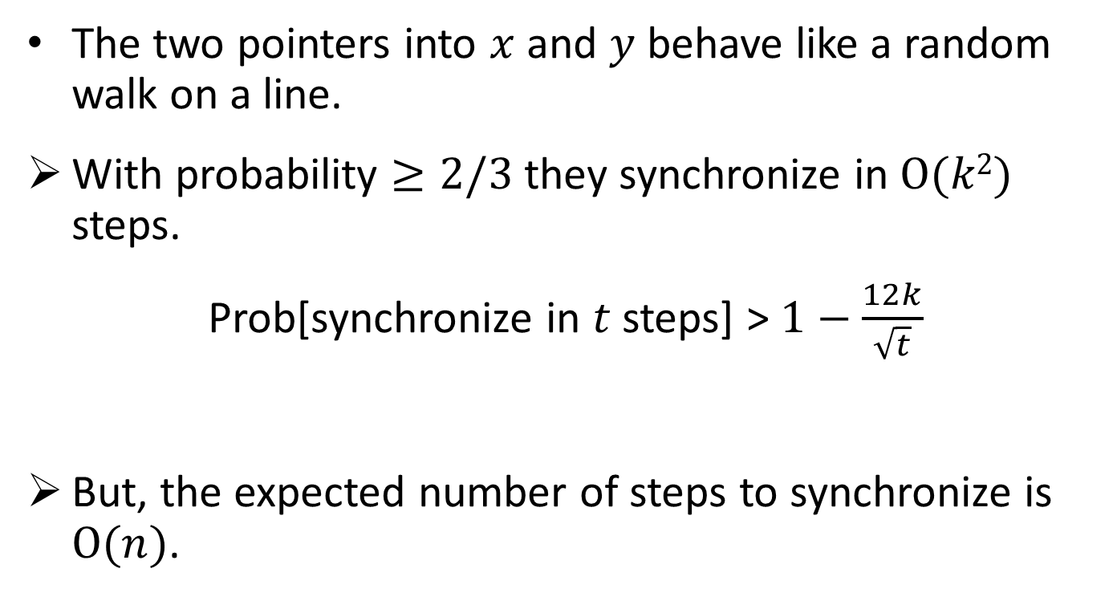
Synchronization
The two pointers into $x$ and $y$ behave like a random walk on a line.
With probability $≥2/3$ they synchronize in $O(k2)$ steps.
Prob[synchronize in $t$ steps] > $1−\frac{12k}{\sqrt{t}}$
But, the expected number of steps to synchronize is $O(n)$.

Slide 11
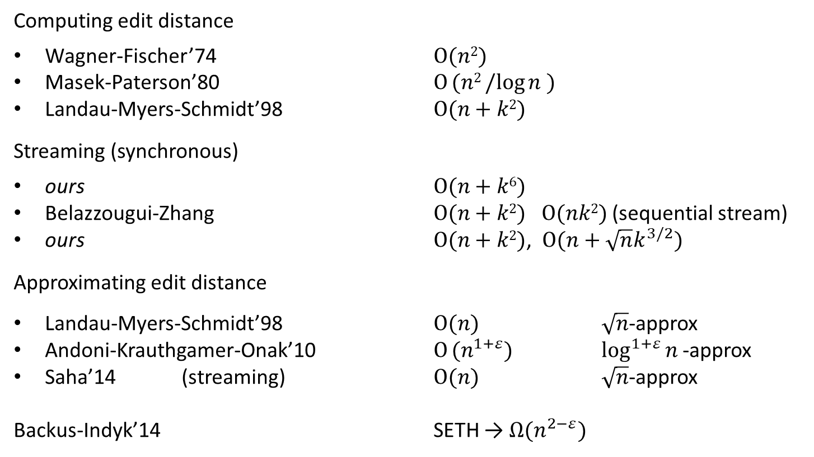
Computing edit distance
Computing edit distance
Wagner-Fischer’74 $O(n2)$
Masek-Paterson’80 $O (n2/log{n )}$
Landau-Myers-Schmidt’98 $O(n+k2)$
Streaming (synchronous)
ours $O(n+k6)$
Belazzougui-Zhang $O(n+k2)$ $O(nk2)$ (sequential stream)
ours $O(n+k2)$, $O(n+\sqrt{n}k^{3/2})$
Approximating edit distance
Landau-Myers-Schmidt’98 $O(n)$ $\sqrt{n}$-approx
Andoni-Krauthgamer-Onak’10 $O (n^{1+ε})$ $\log^{1+ε}{n }$-approx
Saha’14 (streaming) $O(n)$ $\sqrt{n}$-approx
Backus-Indyk’14 SETH → $Ω(n^{2−ε})$

Slide 12
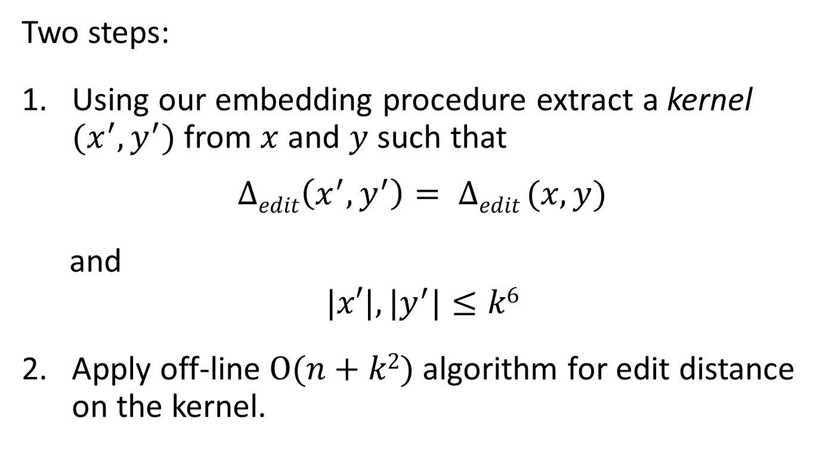
Streaming algorithm for edit distance
Two steps:
Using our embedding procedure extract a kernel $(x^{′},y^{′})$ from $x$ and $y$ such that
$$Δedit\left(x^{′},y^{′}\right)= Δedit (x,y)$$
and
$$|x′|,{|y}^{′}|≤k6$$
Apply off-line $O(n+k2)$ algorithm for edit distance on the kernel.

Slide 13
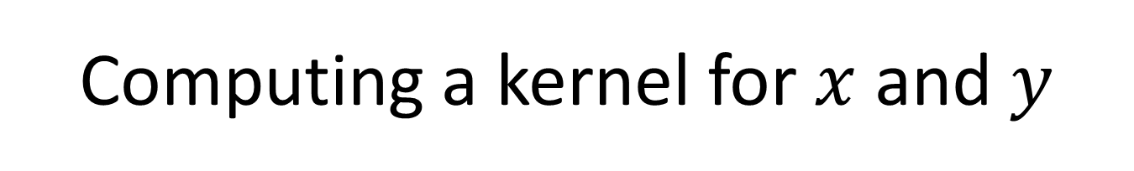

Computing a kernel for $x$ and $y$
Two steps:
Remove too many repetitions from matched parts of $x$ and $y$.
Shrink long rigid matched parts.

Slide 14


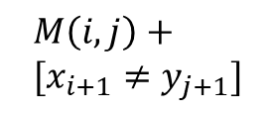




Dynamic pgming for edit distance
$$y_{1..j}$$
$$M\left(i,j\right)+ \\ [x_{i+1}≠y_{j+1}]$$
$$x_{1..i}$$
$$M\left(i,j+1\right)+1$$
$$M(i+1,j+1)$$
$$M\left(i+1,j\right)+1$$
Edit matrix: $M\left(i,j\right)=Δedit {(x}_{1…i},y_{1…j})$

Slide 15
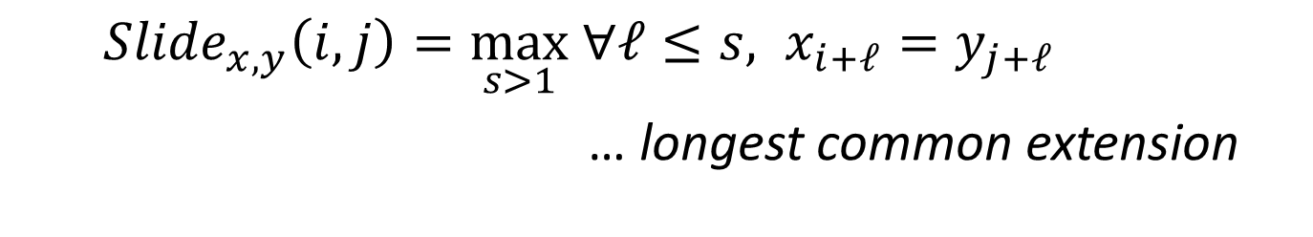



Diagonals
$$[x_{i}≠y_{j}]$$
$$[x_{i+ℓ}=y_{j+ℓ}]$$
$$[x_{i+s}≠y_{j+s}]$$
${Slide}_{x,y}\left(i,j\right)=\max_{s>1} ∀ℓ≤s, x_{i+ℓ}=y_{j+ℓ}$
… longest common extension

Slide 16

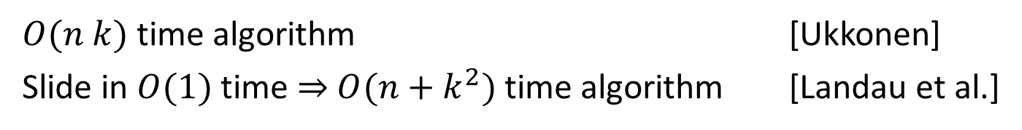

Diagonals
$$k$$
$$k$$
$$[x_{i}≠y_{j}]$$
$$[x_{i+ℓ}=y_{j+ℓ}]$$
$$[x_{i+s}≠y_{j+s}]$$
$O(n k)$ time algorithm [Ukkonen]
Slide in $O(1)$ time $⇒$ $O(n+k^{2})$ time algorithm [Landau et al.]

Slide 17
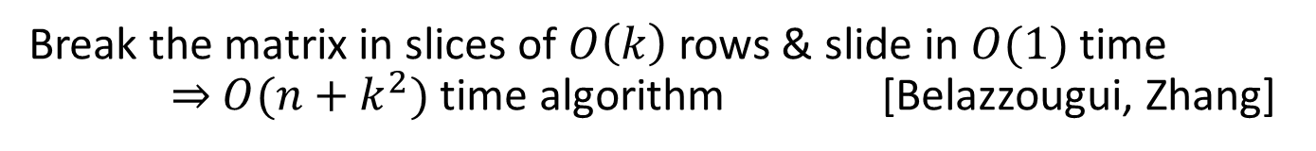

Streaming algorithm (idea)
$$O(k)$$
Break the matrix in slices of $O\left(k\right)$rows & slide in $O(1)$ time $⇒$ $O(n+k^{2})$ time algorithm [Belazzougui, Zhang]

Slide 18







Periodicity
$$y_{1…j}$$
$$w$$
$$w$$
$$x_{1..i}$$
$$w$$
$$w$$
Two diagonals sliding in parallel $⇒$periodicity

Slide 19
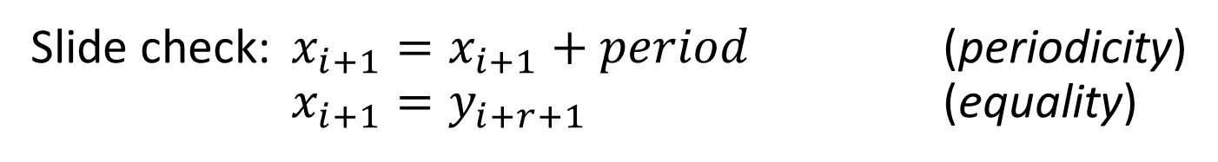

Periodicity
$$y_{1…j}$$
$$w$$
$$w$$
$$x_{1..i}$$
$$j=i+r$$
$$w$$
$$w$$
Slide check: $x_{i+1}=x_{i+1}+period$ (periodicity)
$x_{i+1}=y_{i+r+1}$ (equality)

Slide 20
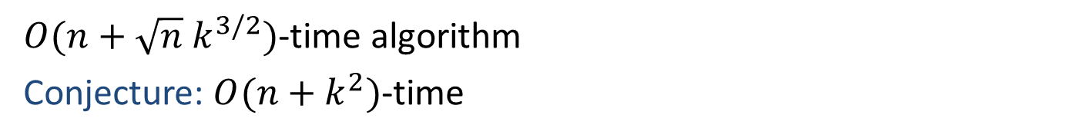
Multiple diagonals
$O(n+\sqrt{n} k^{3/2})$-time algorithm
Conjecture: $O(n+k^{2})$-time

Slide 21
We would like to know
Limits on randomized embedding of edit distance into Hamming distance?
What is the complexity of our edit distance algorithm?

