Slide 1
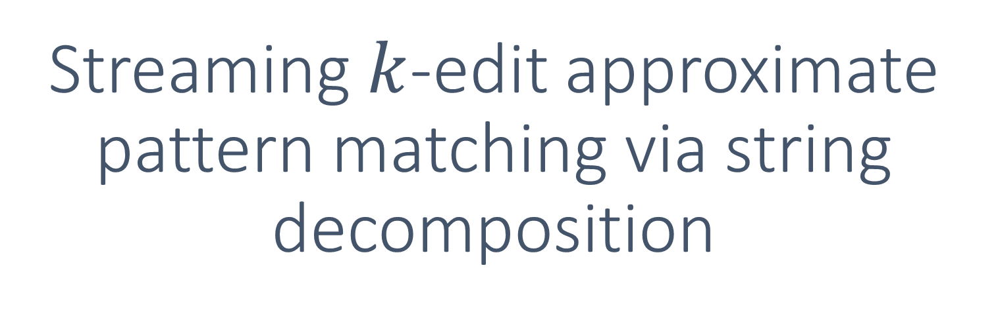
Streaming $k$-edit approximate pattern matching via string decomposition
Sudatta Bhattacharya Michal Koucký
Charles U., Prague

Slide 2

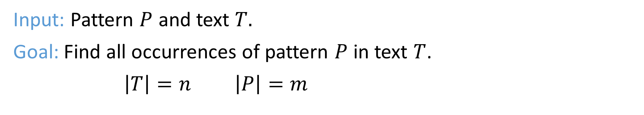

Pattern matching
[Knuth-Morris-Pratt’77, Boyer-Moore’77]
$$T$$
a
b
c
d
e
f
g
h
c
d
e
f
n
$$P$$
c
d
e
f
Input: Pattern $P$ and text $T.$
Goal: Find all occurrences of pattern $P$ in text $T$.
$\left|T\right|=n$ $\left|P\right|=m$

Slide 3
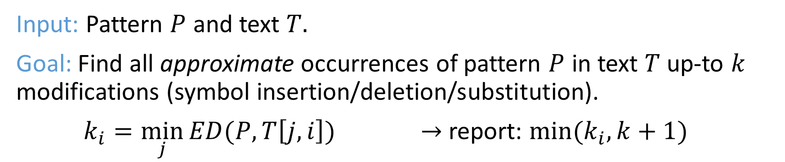
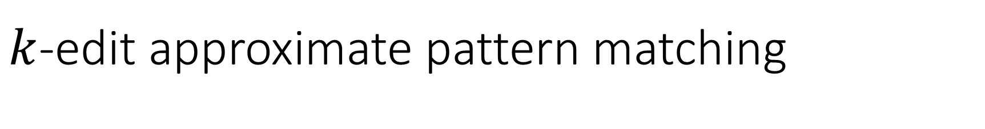
$k$-edit approximate pattern matching
$$T$$
a
b
c
s
e
f
g
h
c
d
i
e
f
n
$$P$$
c
d
e
f
Input: Pattern $P$ and text $T.$
Goal: Find all approximate occurrences of pattern $P$ in text $T$ up-to $k$ modifications (symbol insertion/deletion/substitution).
$k_{i}=\min_{j}{ED(P,T\left[j,i\right])}$ $→$ report: $\min{{(k}_{i},k+1)}$

Slide 4

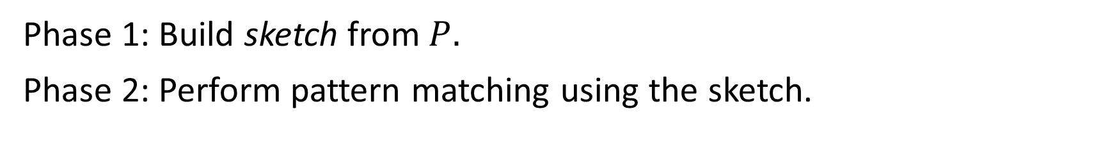
Streaming pattern matching
Phase 2:
$$T$$
a
b
c
s
e
f
g
h
c
d
i
e
f
n
Phase 1:
$$P$$
c
d
e
f
sketch
Phase 1: Build sketch from $P.$
Phase 2: Perform pattern matching using the sketch.

Slide 5

Our result
Streaming $k$-edit pattern matching algorithm that uses:
space $\tilde{O}(k^{2})$ time $\tilde{O}(k^{2})$ per arriving symbol

Slide 6
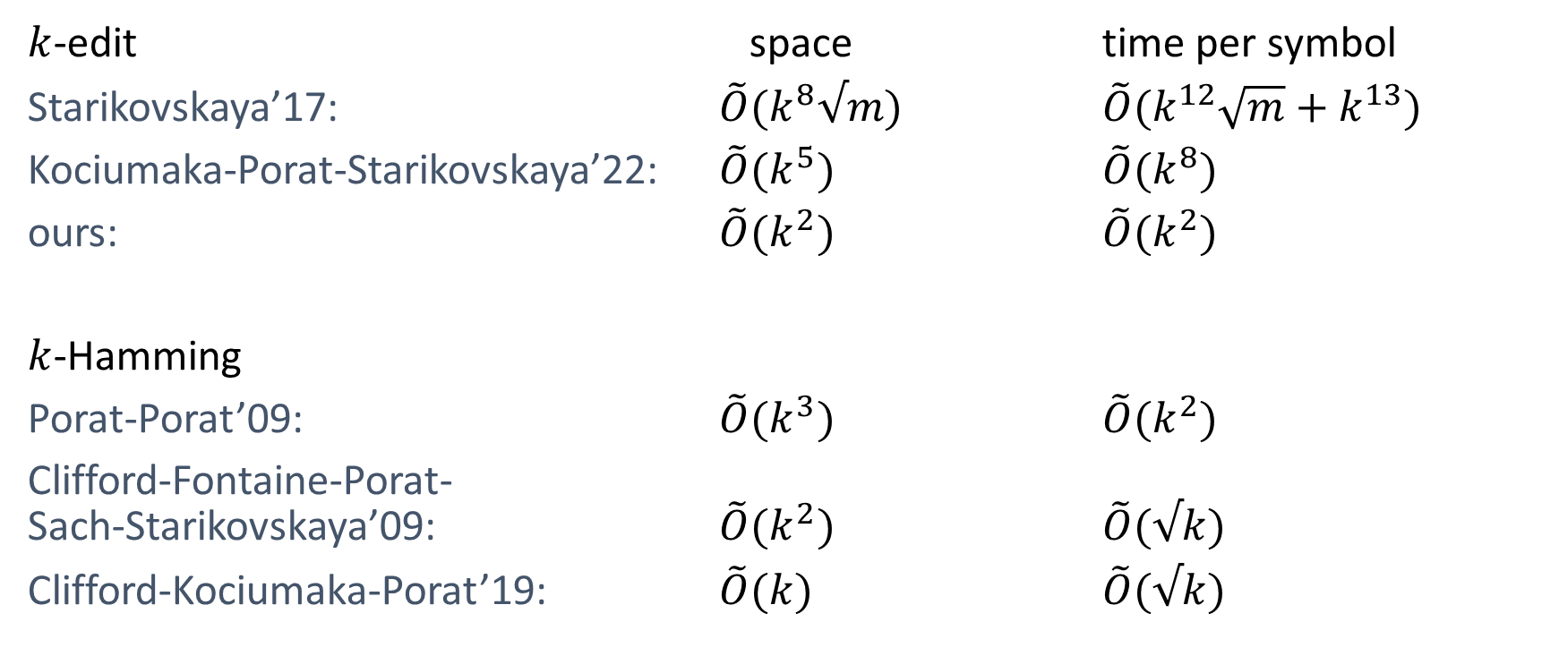
Previous results
$k$-edit space time per symbol
Starikovskaya’17: $\tilde{O}(k^{8}√m)$ $\tilde{O}(k^{12}\sqrt{m}+k^{13})$
Kociumaka-Porat-Starikovskaya’22: $\tilde{O}(k^{5})$ $\tilde{O}(k^{8})$
ours: $\tilde{O}(k^{2})$ $\tilde{O}(k^{2})$
$k$-Hamming
Porat-Porat’09: $\tilde{O}(k^{3})$ $\tilde{O}(k^{2})$
Clifford-Fontaine-Porat-
Sach-Starikovskaya’09: $\tilde{O}(k^{2})$ $\tilde{O}(√k)$
Clifford-Kociumaka-Porat’19: $\tilde{O}(k)$ $\tilde{O}(√k)$

Slide 7




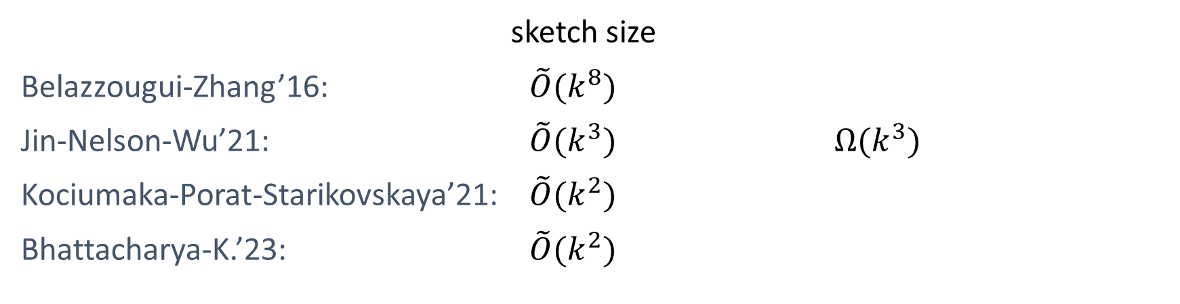

Edit distance sketches
$$x$$
$${\text{sketch}}_{x}$$
$$ED(x,y)$$
$$y$$
$${\text{sketch}}_{y}$$
sketch size
Belazzougui-Zhang’16: $\tilde{O}(k^{8})$
Jin-Nelson-Wu’21: $\tilde{O}(k^{3})$ $Ω(k^{3})$
Kociumaka-Porat-Starikovskaya’21: $\tilde{O}(k^{2})$
Bhattacharya-K.’23: $\tilde{O}(k^{2})$

Slide 8


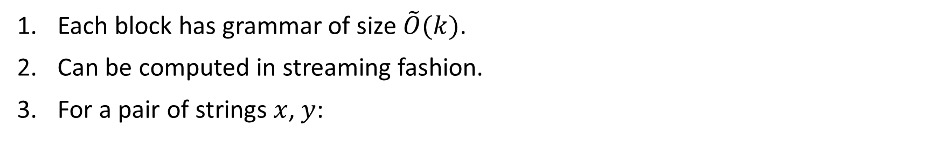


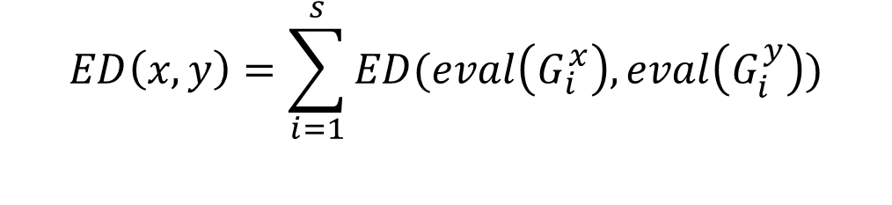









String decomposition
[Bhattacharya-K.’23]
$$x$$
…
$$G_{1}^{x}$$
$$G_{2}^{x}$$
$$G_{s−1}^{x}$$
$$G_{s}^{x}$$
Each block has grammar of size $\tilde{O}(k)$.
Can be computed in streaming fashion.
For a pair of strings $x$, $y$:
$$G_{1}^{x}$$
$$G_{2}^{x}$$
$$G_{s−1}^{x}$$
$$G_{s}^{x}$$
…
$$G_{1}^{y}$$
$$G_{2}^{y}$$
$$G_{s−1}^{y}$$
$$G_{s}^{y}$$
$$ED\left(x,y\right)=\sum_{i=1}^{s}{ED(eval\left(G_{i}^{x}\right), eval\left(G_{i}^{y}\right))}$$

Slide 9










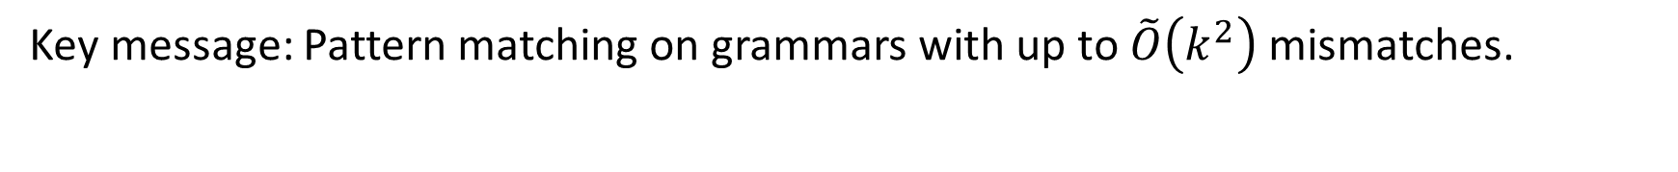

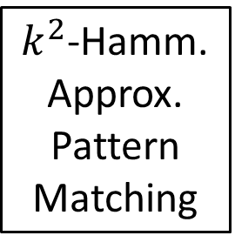
Streaming $k$-edit approximate pattern matching
$k^{2}$-Hamm.
Approx.
Pattern
Matching
…
…
$$G_{t−s+1}^{x}$$
$$G_{t−s+2}^{x}$$
$$G_{t−1}^{x}$$
$$G_{t}^{x}$$
$$T$$
$$G_{1}^{y}$$
$$G_{2}^{y}$$
…
$$G_{s−1}^{y}$$
$$G_{s}^{y}$$
$$P$$
Clifford-Kociumaka-Porat’19
Key message: Pattern matching on grammars with up to $\tilde{O}\left(k^{2}\right)$ mismatches.

Slide 10

Open problems
Smaller space: $O(k)$ ?
Recover the edit operations ?

