Slide 1
Lower Bounds for Combinatorial Algorithms for Boolean Matrix Multiplication
Michal Koucký
Charles University
Joint work with: Debarati Das and Mike Saks

Slide 2

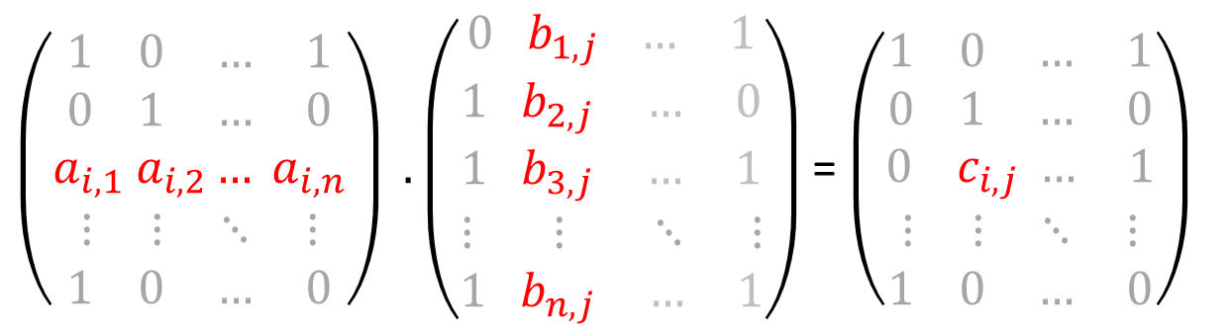
Boolean Matrix Multiplication (BMM)
$\left(\begin{aligned}1 0 … 1 \\ 0 1 … 0 \\ a_{i,1} a_{i,2}… a_{i,n} \\ ⋮ ⋮ ⋱ ⋮ \\ 1 0 … 0\end{aligned}\right) . \left(\begin{aligned}0 b_{1,j} … 1 \\ 1 b_{2,j} … 0 \\ 1 b_{3,j} … 1 \\ ⋮ ⋮ ⋱ ⋮ \\ 1 b_{n,j} … 1\end{aligned}\right)$ = $\left(\begin{aligned}1 0 … 1 \\ 0 1 … 0 \\ 0 { c}_{i,j} … 1 \\ ⋮ ⋮ ⋱ ⋮ \\ 1 0 … 0\end{aligned}\right)$
Multiplication over Boolean semi-ring:
$$c_{i,j}=⋁_{k=1}^{n} (a_{i,k}∧b_{k,j})$$

Slide 3








Boolean Matrix Multiplication (BMM)
$$P⋅Q=R$$
$$P$$
$$Q$$
$$k$$
$$i$$
$$j$$
$$A$$
$$B$$
$$C$$

Slide 4
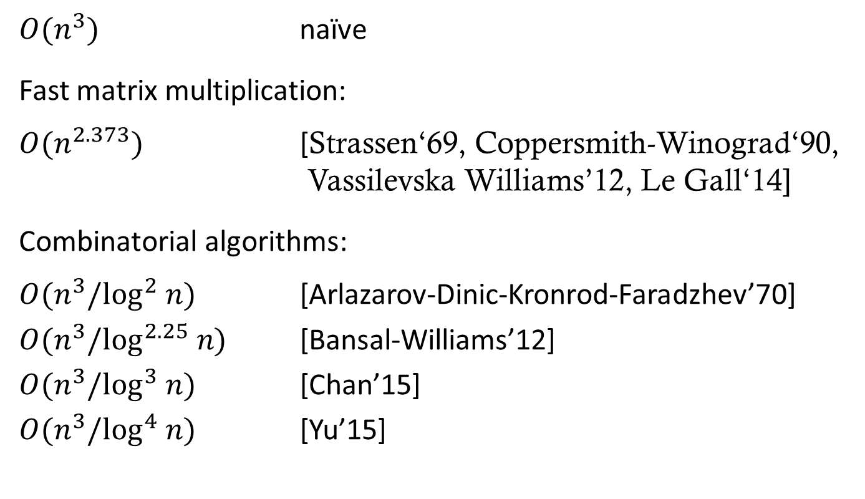
Algorithms for BMM
$O(n^{3})$ naïve
Fast matrix multiplication:
$O(n^{2.373})$ [Strassen‘69, Coppersmith-Winograd‘90, Vassilevska Williams’12, Le Gall‘14]
Combinatorial algorithms:
$O(n^{3}/\log^{2} n)$ [Arlazarov-Dinic-Kronrod-Faradzhev’70]
$O(n^{3}/\log^{2.25} n)$ [Bansal-Williams’12]
$O(n^{3}/\log^{3} n)$ [Chan’15]
$O(n^{3}/\log^{4} n)$ [Yu’15]

Slide 5
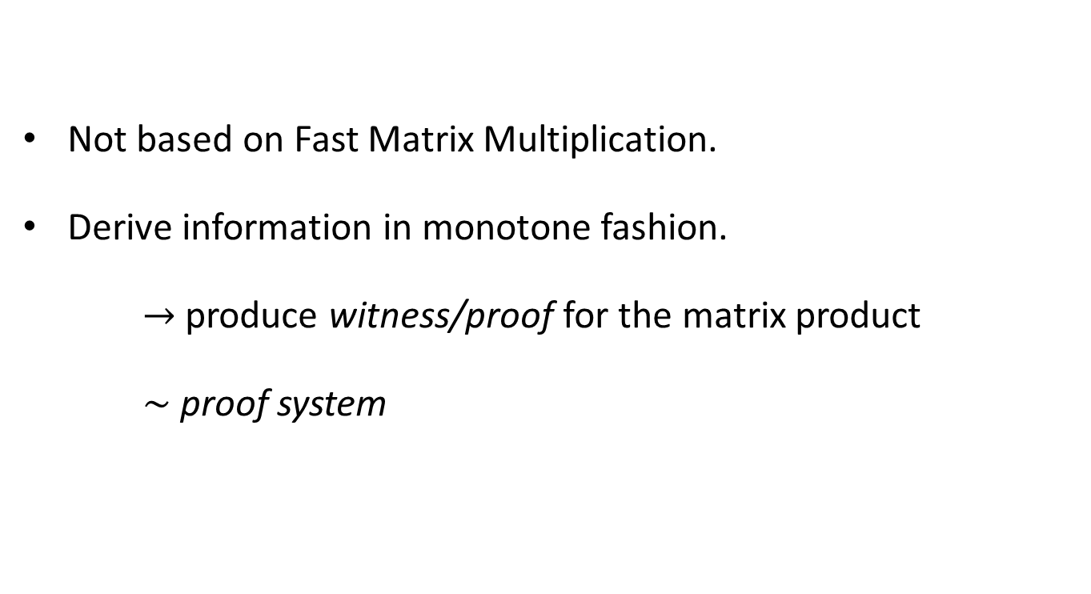
Combinatorial algorithms
Not based on Fast Matrix Multiplication.
Derive information in monotone fashion.
$→$produce witness/proof for the matrix product
$∼$ proof system

Slide 6
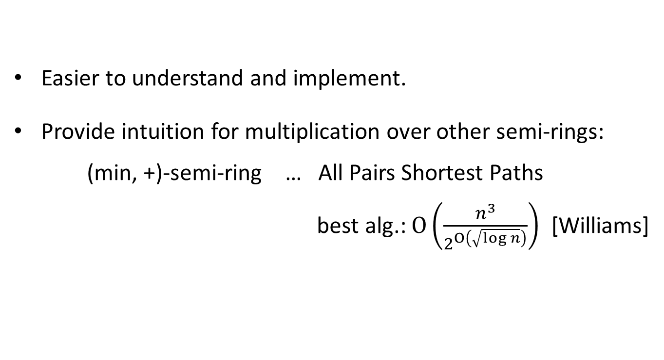
Why combinatorial algorithms?
Easier to understand and implement.
Provide intuition for multiplication over other semi-rings:
(min, +)-semi-ring … All Pairs Shortest Paths
best alg.: $O\left(\frac{n^{3}}{2^{O\left(\sqrt{\log{n}}\right)}}\right)$ [Williams]

Slide 7





Angluin’s model (1976)
$$×$$
$$=$$
1 0 1 1
$$P$$
$$Q$$
$$R$$
Each resulting row – union of rows of $Q.$

Slide 8
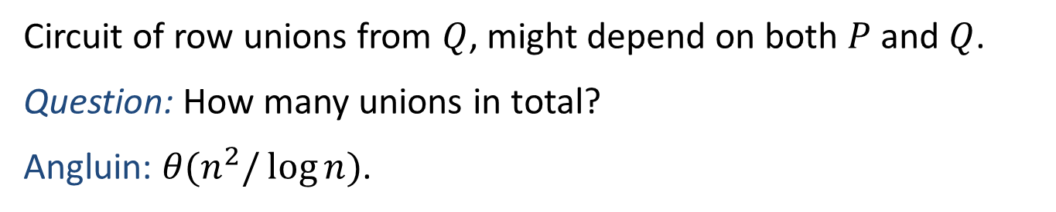
Angluin’s model (1976)
$$Q$$
Circuit of row unions from $Q$, might depend on both $P$ and $Q$.
Question: How many unions in total?
Angluin: $θ(n^{2}/\log{n})$.

Slide 9
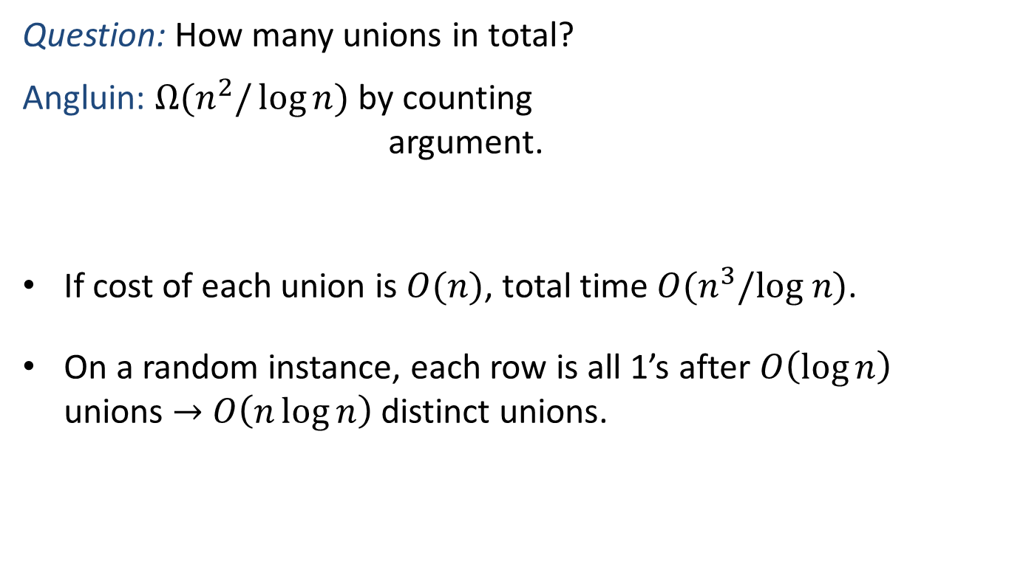

Angluin’s model (1976)
Question: How many unions in total?
Angluin: $Ω(n^{2}/\log{n})$ by counting
argument.
If cost of each union is $O(n)$, total time $O(n^{3}/log n)$.
On a random instance, each row is all 1’s after $O\left(\log{n}\right)$ unions $→$ $O\left(n\log{n}\right)$ distinct unions.
$$Q$$

Slide 10
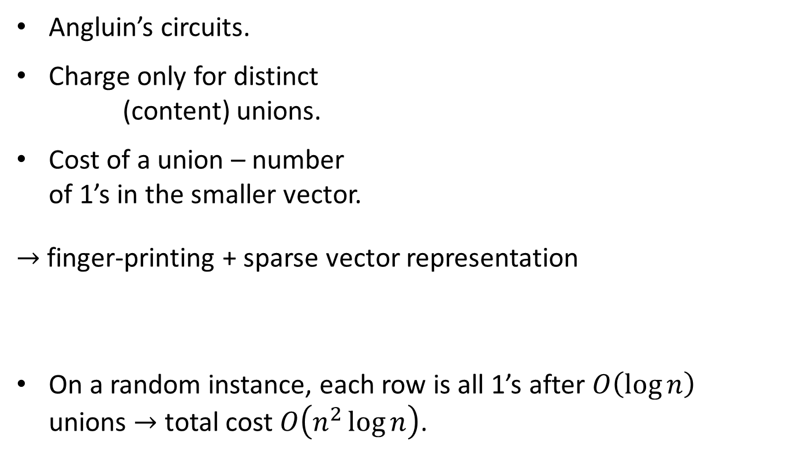
Our model #1
Angluin’s circuits.
Charge only for distinct
(content) unions.
Cost of a union – number
of 1’s in the smaller vector.
$→$ finger-printing + sparse vector representation
On a random instance, each row is all 1’s after $O\left(\log{n}\right)$ unions $→$ total cost $O\left(n^{2}\log{n}\right)$.
$$Q$$

Slide 11
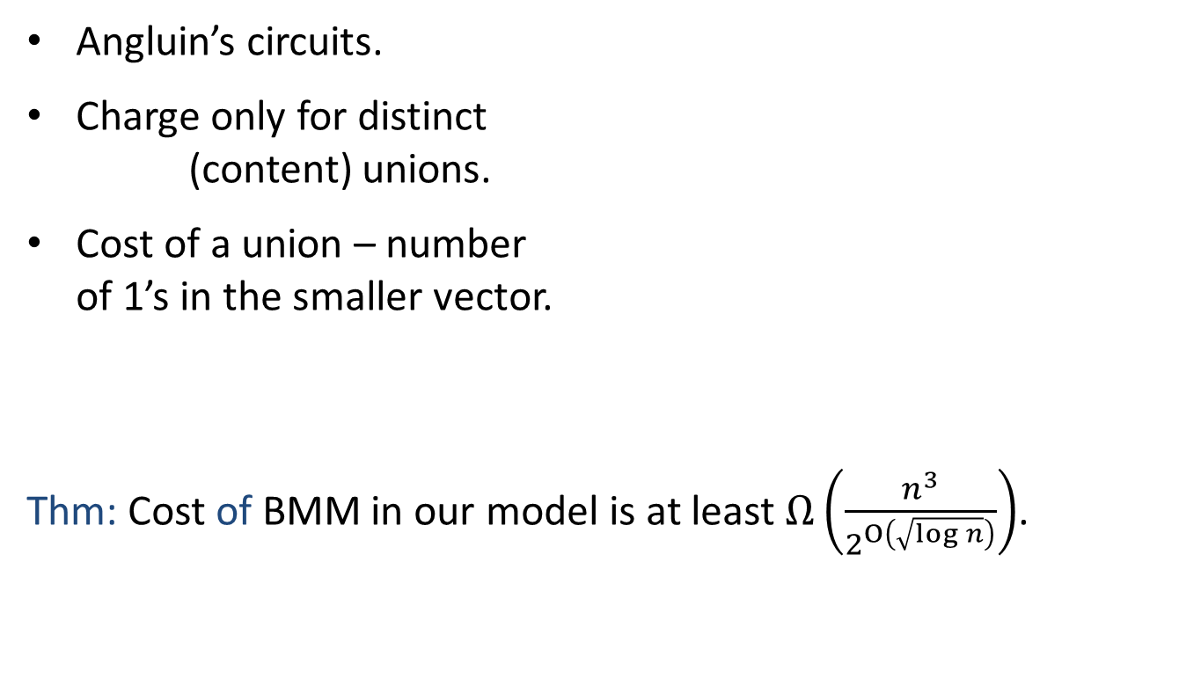
Our result #1
Angluin’s circuits.
Charge only for distinct
(content) unions.
Cost of a union – number
of 1’s in the smaller vector.
Thm: Cost of BMM in our model is at least $Ω\left(\frac{n^{3}}{2^{O\left(\sqrt{\log{n}}\right)}}\right)$.
$$Q$$

Slide 12

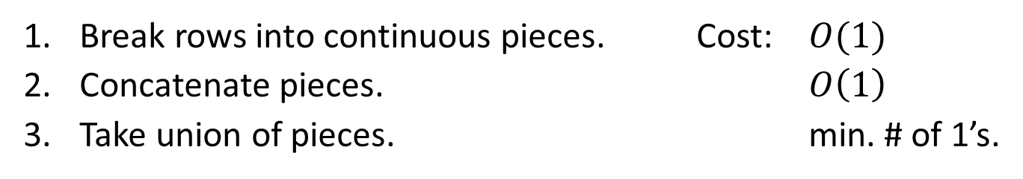
Our model #2
$$Q$$
Break rows into continuous pieces. Cost: $O(1)$
Concatenate pieces. $O\left(1\right)$
Take union of pieces. min. # of 1’s.

Slide 13
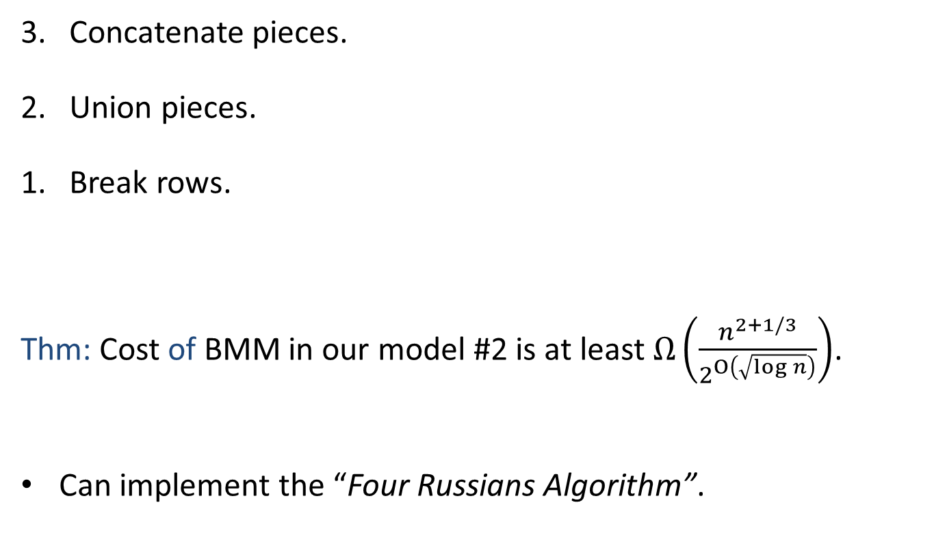




Our result #2
3. Concatenate pieces.
2. Union pieces.
1. Break rows.
Thm: Cost of BMM in our model #2 is at least $Ω\left(\frac{n^{2+1/3}}{2^{O\left(\sqrt{\log{n}}\right)}}\right)$.
Can implement the “Four Russians Algorithm”.
$$↑$$
$$↑$$
$$Q$$
$$Q$$

Slide 14
Generalized model
Break rows into continuous pieces.
Concatenate pieces.
Take union of pieces.
Question 1: What’s the cost when one mixes the operations in arbitrary order?
Question 2: What’s the right choice of cost function?
$$Q$$
$$Q$$

Slide 15



Hard graphs
Rusza-Szemerédi (1978): There exists a bipartite graph on $2n$ vertices which is a union of $n/3$ disjoint induced matchings each of size $n/2^{θ(\sqrt{\log{n}})}$.
$$A$$
$$C$$

Slide 16




Hard graphs
Rusza-Szemerédi (1978): There exists a bipartite graph on $2n$ vertices which is a union of $n/3$ disjoint induced matchings each of size $n/2^{θ(\sqrt{\log{n}})}$.
matchings
$$A$$
$$B$$
$$C$$

Slide 17

Hard graphs
Dense graph with $n^{2}/2^{θ(\sqrt{\log{n}})}$ pairs of vertices which are connected via a unique path.
matchings
$$A$$
$$B$$
$$C$$

Slide 18
Open problems
The right model of combinatorial algorithms?
New combinatorial algorithms?
Lower bounds on combinatorial algorithms?

