Slide 1
Catalytic computation
Michal Koucký
Charles University
Based on joint work with: H. Buhrman, R. Cleve, B. Loff, F. Speelman, …

Slide 2
Space hierarchy
space S space S’
Hierarchy theorem:
If S ≪ S’ then DSPACE(S) ⊊ DSPACE(S’)
More space, more functions

Slide 3
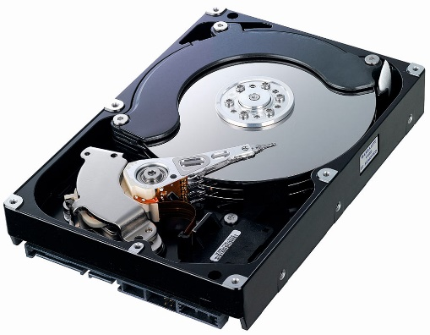
Space hierarchy
+
space S space S + hard drive full of data
Question: Can we use the hard drive to compute more?
Content of the hard drive must be preserved at end of computation.

Slide 4
Catalytic computation
x
input tape RO
w
…
…
work tapes RW
space S
Q
w'
2^{S}
a
auxiliary tapes RW
a'
After finishing the computation on input x, the auxiliary tapes must contain their original content a.

Slide 5
Catalytic computation
DSPACE(S) … functions computable using O(S) work space
CSPACE(S) … functions computable using O(S) work space and 2^{O(S)} catalyst space.
Clearly: DSPACE(S) ⊆ CSPACE(S).
Question: CSPACE(S) ⊆ DSPACE(S)?

Slide 6
Power of catalytic computation
LOG = DSPACE(log n) deterministic log-space
NLOG = NSPACE(log n) non-deterministic log-space
CLOG = CSPACE(log n) catalytic log-space
Thm: LOG ⊆ NLOG ⊆ LOGCFL ⊆ CLOG.
CLOG can compute:
Determinant over Z
Product of n nxn matrices over Z
Functions computable by log-depth threshold circuits (TC¹)
Functions computable by polynomial-size arithmetic circuits of polynomial degree over Z (Valiant’s P)

Slide 7
Reversibility
w
a
y
b
w
a
work tape auxiliary tape

Slide 8
Ordinary computation
0
1
t
s
0
q
Two different configurations can lead to the same configuration

Slide 9
Reversible computation
1
s
0
q
For each configuration at most one previous configuration.

Slide 10
Reversible computation
Studied already in ‘60-’70
Physicists interested in reversible computation as it does not have to lose energy
Erasing information always leads to release of energy
Operations of quantum computers are reversible (except for measurements)

Slide 11
Reversible computation
Bennet 80’s: Any computation can be simulated reversibly.
space S and time T irreversible → space S log T and time T ^{1+ε} reversible
Approach: Record history of actions taken by the Turing machine on an extra history tape.
XOR the description of actions with the content of the history tape.
Disadvantage: History tape has to be set to all zero at the beginning.

Slide 12
Reversible computation
Lange-McKenzie-Tapp 90’s: Any computation can be simulated reversibly.
space S and time T irreversible → space S and time 2^{T} reversible
Approach: Traverse reversibly the configuration graph.
Disadvantage:
Takes long time.
Requires clock to revert to the initial state.

Slide 13
Reversible circuits
Toffoli gate
b=1, c=1 → NOT
c=0 → AND
Can simulate arbitrary Boolean circuits.
Disadvantage: Needs a particular setting of auxiliary bits.
a b c ⊕ (a & b)
a b c

Slide 14
Branching programs, straight-line programs …
Barrington 88: Permutation branching programs of width five can evaluate Boolean formula.
Ben-Or & Cleve’89: Straight-line programs with three registers can evaluate formula over arbitrary ring R(+,∙).
Program using instructions of the form:
r_{i} ← r_{i} + r_{j} * x_{k}
or
r_{i} ← r_{i} – r_{j} * x_{k}
+
∙
+
+
∙
x₂
∙
→
x₇
x₁
x₁
x₇
x₃
+
x₈
x₁

Slide 15
Ben-Or & Cleve
Formula of depth d → program with 4^{d} instructions
r₁ ← r₁ + r₂ * f(x)
r₁ ← r₁ + r₂ * g(x)
r₃ ← r₃ + r₂ * f(x)
r₁ ← r₁ + r₃ * g(x)
r₃ ← r₃ – r₂ * f(x)
r₁ ← r₁ – r₃ * g(x)
r₁ ← r₁ + r₂ * (f + g)(x)
r₁ ← r₁ + r₂ * (f * g)(x)

Slide 16
Transparent computation
Straight-line program on a register machine
Input registers: x₁, x₂, …, x_{n}
Working registers: r₁, r₂, …, r_{m}
Instructions: r_{i} ← r_{i} ± u * v u, v ∊ {x₁, …, x_{n}, r₁, …, r_{m}}
Def: Program P computes a function f transparently if it causes:
r₁ ← r₁ + f(x₁, x₂, …, x_{n})
regardless of the initial values of working registers r₁, …, r_{m}.

Slide 17
Transparent computation
Ben-Or & Cleve: Formulas can be computed transparently.
Thm: Functions in TC¹ can be computed transparently over Z_{p}.
Thm: Functions that have polynomial-size arithmetic circuits of polynomial degree can be computed transparently (Valiant’s P).
Question: Can x^{2n} be computed transparently?

Slide 18
Back to catalytic computation
We can simulate transparent program using catalytic memory.
copy P
substract P ^{–1}
working tape auxiliary tape
r₁
r₁
r₂
…
r_{m}
f
r₁+f
?
…
?
f
r₁
r₂
…
r_{m}

Slide 19
Power of catalytic computation
CLOG can compute:
Determinant over Z
Product of n nxn matrices over Z
Functions computable by log-depth threshold circuits (TC¹)
Functions computable by polynomial-size arithmetic circuits of polynomial degree over Z (Valiant’s P)

Slide 20
Power of catalytic computation
Is the power surprising? YES!
work space catalytic space
Two cases
a is compressible: compress, do PSPACE computation, decompress
a is incompressible: use a as a random string for randomized log-space computation
… but presumably RLOG=LOG
w
a

Slide 21
Is CLOG=PSPACE?
YES, in some universe!
There is an oracle A so that CLOG^{A}=PSPACE^{A}
But unlikely in our world:
CLOG ⊆ ZPP
Presumably ZPP=P and PSPACE≠P in our world
Question: Is CLOG ⊆ P?

Slide 22
CLOG ⊆ ZPP
Cannot happen:
Roughly 2^{|w|}2^{|a|} possible configurations
Computations on different auxiliary content cannot share the same configuration
The length of computation at most 2^{|w|} configurations on average
→ Pick a at random and run the CLOG computation.
w
a
w
a'
w’
a''

Slide 23
Determinism vs non-determinism
Savitch: NLOG ⊆ LOG²
Question: CNLOG ⊆ CLOG²?
Immerman-Szelepsenyi: NLOG ⊆ coNLOG
Question: CNLOG ⊆ coCNLOG?
Partical answer: Yes, under standard derandomization hypothesis.

Slide 24
Space hierarchy
DSPACE(S) ≠ DSPACE(S²)
Question: CSPACE(S) ≠ CSPACE(S²) ?
Partical answer: CSPACE(S)/O(1) ≠ CSPACE(S²)/O(1)
Problem: We do not know how to enumerate catalytic machines.

Slide 25
Space hierarchy
DSPACE(S) ≠ DSPACE(S²)
Question: CSPACE(S) ≠ CSPACE(S²) ?
Partical answer: CSPACE(S)/O(1) ≠ CSPACE(S²)/O(1)
Problem: We do not know how to enumerate catalytic machines.

Slide 26
Space hierarchy
DSPACE(S) ≠ DSPACE(S²)
Question: CSPACE(S) ≠ CSPACE(S²) ?
Partical answer: CSPACE(S)/O(1) ≠ CSPACE(S²)/O(1)
Problem: We do not know how to enumerate catalytic machines.

Slide 27
Space hierarchy
DSPACE(S) ≠ DSPACE(S²)
Question: CSPACE(S) ≠ CSPACE(S²) ?
Partical answer: CSPACE(S)/O(1) ≠ CSPACE(S²)/O(1)
Problem: We do not know how to enumerate catalytic machines.

Slide 28
Space hierarchy
DSPACE(S) ≠ DSPACE(S²)
Question: CSPACE(S) ≠ CSPACE(S²) ?
Partical answer: CSPACE(S)/O(1) ≠ CSPACE(S²)/O(1)
Problem: We do not know how to enumerate catalytic machines.

Slide 29
Space hierarchy
DSPACE(S) ≠ DSPACE(S²)
Question: CSPACE(S) ≠ CSPACE(S²) ?
Partical answer: CSPACE(S)/O(1) ≠ CSPACE(S²)/O(1)
Problem: We do not know how to enumerate catalytic machines.

Slide 30
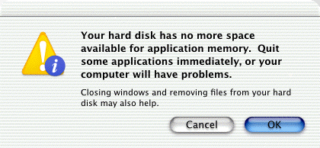
Catalytic computation
Michal Koucký
Charles University
Based on joint work with: H. Buhrman, R. Cleve, B. Loff, F. Speelman, …

