Slide 1
Multiparty Communication Complexity
(A biased introduction)
Arkadev Chattopadhyay
TIFR, Mumbai
TexPoint fonts used in EMF.
Read the TexPoint manual before you delete this box.: AAAAAAAAAA

Slide 2
Yao’s 2-Party Model of 1979
Unbounded
Computational
Power
Unbounded
Computational
Power
a₁
= a₁(X)
X
b₁
= b₁ (Y,a₁)
Y
110111001
a₂
= a₂(X,b₁)
000111111
n
n
b_{r}
= b_{r}(Y,a₁,☹,a_{r})
Alice
Bob
Alice and Bob collaborate to compute f(X,Y).
Aim to minimize the communication cost.
Complexity of any f is at most n+1.
TexPoint fonts used in EMF.
Read the TexPoint manual before you delete this box.: AAAAAAA

Slide 3
Easy Functions
My Parity is
odd
0 (Even)
X
Y
PARITY(X,Y)=1
110111001
001111111
Alice
Bob
Compute PARITY(X,Y).
CC(PARITY) = 2.
CC(MAJORITY) = O(log n).
TexPoint fonts used in EMF.
Read the TexPoint manual before you delete this box.: AAAAAAA

Slide 4
Hard Functions
How about EQ(X,Y), i.e. is X=Y?
Intuitively, this should require n bits of communication!
Needs an argument!
TexPoint fonts used in EMF.
Read the TexPoint manual before you delete this box.: AAAAAAA

Slide 5
Rectangularity of Protocols
¼(X,Y)
X
Y
=
X’
¼(X’,Y’)
Y’
=
X
¼ (X,Y’)
Y’
=
X’
Alice
¼ (X’,Y)
Bob
Y
Observation. Every transcript corresponds to a rectangle of form R_{X} £ C_{Y}.
TexPoint fonts used in EMF.
Read the TexPoint manual before you delete this box.: AAAAAAA

Slide 6
Diagonals are Hard to Cover
Y
00
01
10
11
1 | 0 | 0 | 0
0 | 1 | 0 | 0
0 | 0 | 1 | 0
0 | 0 | 0 | 1
CC(Equality)
¸ log (2^{n}) + 1
00
X,Y
X,Y’
01
X
= n + 1.
10
X’,Y
X’,Y’
11
Fact: No two 1’s on diagonal share the same transcript.
TexPoint fonts used in EMF.
Read the TexPoint manual before you delete this box.: AAAAAAA

Slide 7
Set-Disjointness
Disj(x,y) = 0 iff for some i, x_{i} = y_{i} = 1.
Alice
1 | 0 | 1 | 1 | 0 | 1 | 0 | 0 | 1
1 | 1 | 0 | 1 | 0 | 1 | 1 | 0 | 1
Disj(A,B)=0
Bob
CC(Disj)
¸ n + 1
Suppose ¼(a,a^{c}) = ¼(b,b^{c})
Contradiction!
Then ¼(a,b^{c}) = ¼(b,a^{c}) = ¼(a,a^{c}) = ¼(b,b^{c})
Conclusion: All 2^{n} inputs of form (x,x^{c}) have
distinct transcripts.
TexPoint fonts used in EMF.
Read the TexPoint manual before you delete this box.: AAAAAAA

Slide 8
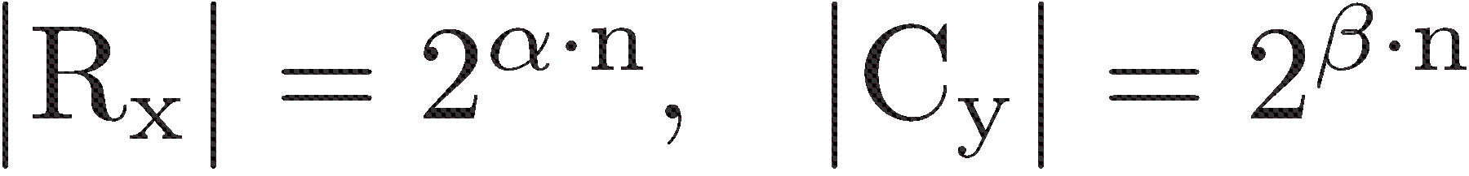
Inner-Product
IP(x,y) ´ ∑_{ι} x_{i} ¢ y_{i} (mod 2)
Alice
1 | 0 | 1 | 1 | 0 | 1 | 0 | 0 | 1
1 | 1 | 0 | 1 | 0 | 1 | 1 | 0 | 0
x
IP(X,Y)=1
Bob
y
R_{x} £ C_{y} be 0-monochromatic.
x¹,☹, x^{®n}
Lin. Ind.
y¹,☹, y^{¯n}
Lin. Ind.
®+¯ · 1
x^{i}¢y^{j} = 0
Concl: Size of monochromatic rectangle is at most 2^{n}.
CC(IP) ¸ n – o(n)
TexPoint fonts used in EMF.
Read the TexPoint manual before you delete this box.: AAAAAAA

Slide 9
Can randomization help?
One central theme of theory of computation.
TexPoint fonts used in EMF.
Read the TexPoint manual before you delete this box.: AAAAAAA

Slide 10
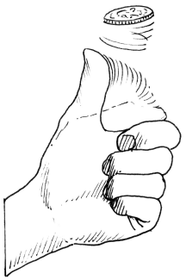
The Power of Randomness
0
0
1
0
1
0
= r
<Y,r> mod 2 =0
<X,r> mod 2
= 1
X ≠ Y
X
0
Y
1 1 0 1 1 1
1 0 1 1 1 0
Alice
Bob
Compute EQUALITY(X,Y).
R_{1/2} (EQ) = 2.
Randomized protocols can be much more
powerful than deterministic ones.
TexPoint fonts used in EMF.
Read the TexPoint manual before you delete this box.: AAAAAAA

Slide 11
Limits of Random Protocols
Set-Disjointness:
Disj(x,y) = 0 iff for some i, x_{i} = y_{i} = 1.
R(Set-Disj) = Ω(n).
(Kalyanasundaram-Schnitger’87, Razborov’90).
Alice
1 | 0 | 1 | 1 | 0 | 1 | 0 | 0 | 1
1 | 1 | 0 | 1 | 0 | 1 | 1 | 0 | 1
Disj(A,B)=0
Bob
Celebrated Result
TexPoint fonts used in EMF.
Read the TexPoint manual before you delete this box.: AAAAAAA

Slide 12
Streaming Computation
1 | 2 | 4 | 8 | 1 | 5 | 7 | 4 | 3 | 2 | 2 | 4 | 5 | 1 | 1 | 1 | 9 | 5 | 3 | 1 | 2 | 7 | 3 | 8 | 8 | 5
D[1,☹,m]
0 | 0 | 0 | 0
0 | 1 | 1 | 1
1 | 0 | 0 | 1
1 | 1 | 0 | 1
D[i] 2 {1,☹, n}
S
Goal: Answer questions about the frequency
distribution on {1,☹,n}.
Problem: How much space S is needed to
approximate the maximal frequency?
TexPoint fonts used in EMF.
Read the TexPoint manual before you delete this box.: AAAAAAA

Slide 13
Application to Streaming
How much space needed to compute max frequency?
S bits
X
Y
0
110100
001111
Alice
Bob
A_{x}
1 | 2 | 4
3 | 4 | 5 | 6
B_{y}
|A_{x} [ B_{y}|₁ = 2
S
Concl: |M| ₁ needs Ω(N) space
TexPoint fonts used in EMF.
Read the TexPoint manual before you delete this box.: AAAAAAA

Slide 14
Many More Applications…
Data Structures.
Circuit complexity.
Pseudo-randomness.
Combinatorial Optimization.
Property Testing.
(Swiss-Army Knife of Computer Scientists)
TexPoint fonts used in EMF.
Read the TexPoint manual before you delete this box.: AAAAAAA

Slide 15
Multiparty Communication
TexPoint fonts used in EMF.
Read the TexPoint manual before you delete this box.: AAAAAAA

Slide 16
Number-on-Forehead Model
Chandra-Furst-Lipton’83
010001110
110111001
1101
0111
1101
Alice
111000001
Bob
Every pair of bits visible to someone.
Overlap of Information
Fewer and fewer information missing
from a player.
Lower bounds are challenging
Charlie
TexPoint fonts used in EMF. Read the TexPoint manual before you delete this box.: AAAAAAA

Slide 17
Foreheads Make a Difference
EQUALITY is hard for 2 parties!
Y
X
1
1
Is Z=X?
Z
Is X=Y?
Alice
Bob
2-bit protocol
Is EQ(X,Y,Z)?
Exploits Information Overlap
Charlie
TexPoint fonts used in EMF. Read the TexPoint manual before you delete this box.: AAAAAAA

Slide 18
NOF Lower Bounds Benefits
Circuit Lower Bounds
Branching Program Lower Bounds
Pseudo-random generators
Lower bounds on length of proofs
Data-structure lower bounds
More to be discovered….
TexPoint fonts used in EMF. Read the TexPoint manual before you delete this box.: AAAAAAA

Slide 19
Constant-Depth Circuits
Conjecture (Smolensky’87): MAJ needs exponential size circuits of constant depth having AND/OR/MOD_{m} gates.
ACC⁰ ´ {fns having poly-size ckts with AND/OR/MOD gates}.
Open: Is NP µ ACC⁰ ?
TexPoint fonts used in EMF. Read the TexPoint manual before you delete this box.: AAAAAAA

Slide 20


Bounded Depth Circuits
f computed by constant-depth circuits with AND/OR/MOD gates efficiently,
AND
AND
AND
SYMM
f
Beigel –Tarui’91
Beige
TexPoint fonts used in EMF.
Read the TexPoint manual before you delete this box.: AAAAAAA

Slide 21
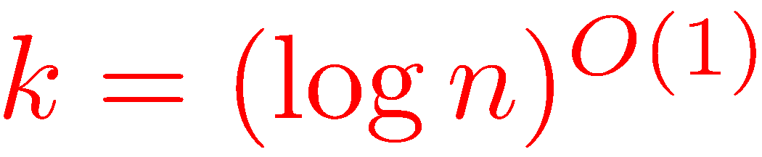
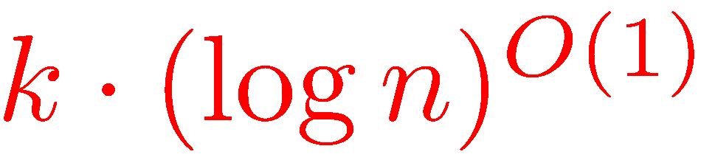
Protocols for Depth 2
Observ: Each AND gate can
be computed by one player.
AND
AND
AND
SYMM
f
Question: k+1-party NOF complexity of f ?
Protocol:
Players 1,☹,k send the number of AND gates they see firing 1,
communicating only poly-log bits each.
Player k+1 announces the answer.
TexPoint fonts used in EMF.
Read the TexPoint manual before you delete this box.: AAAAAAA

Slide 22
NOF Attack on ACC
Theorem: Every f 2 ACC⁰ has poly-log(n) simultaneous k-party communication complexity for some k = poly-log(n), under every input partition.
Corollary of Beigel-Tarui’91
Major Goal: Find f that is hard for large number of players.
TexPoint fonts used in EMF. Read the TexPoint manual before you delete this box.: AAAAAAA

Slide 23
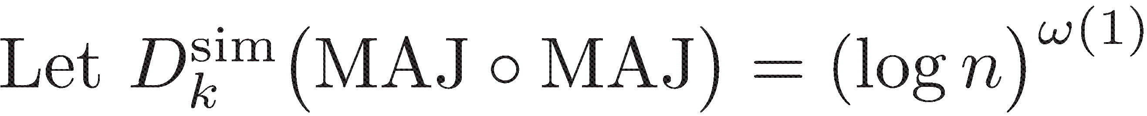
A Conjecture
f:{0,1}^{n} ! {0,1}
q:{0,1}^{k} ! {0,1} .
(f±q) (X₁,X₂,☹,X_{k}) =
f(q(C₁),q(C₂),…,q(C_{n}))
0
1
0
1
1
0
0
X₁
0 | 1 | 1 | 1 | 1 | 1 | 1
1 | 1 | 0 | 1 | 1 | 0 | 1
0 | 1 | 1 | 1 | 1 | 0 | 0
. | . | . | . | . | . | .
. | . | . | . | . | . | .
1 | 1 | 1 | 1 | 1 | 1 | 0
Question: Complexity of (MAJ ± MAJ)?
X₂
Observation:
X₃
) MAJ ± MAJ ∉ ACC⁰
a la Beigel-Tarui’91
) MAJ ∉ ACC⁰
X_{k}
Proposed by Babai-Kimmel-Lokam’95
n

Slide 24
Examples of Composition
k=2
Popular Names
Deterministic
Randomized
£(n).
£(n).
PARITY ± AND
´ IP
Complexity ?
Folklore
Chor-Goldreich’85
Discrepancy
NOR ± AND
´ Set-Disj
£(n).
£(n).
Complexity ?
Folklore
KS’87, Razborov’90
BJKS’02
Very influential
Remark 1: Argument for Set-Disj spawned many new techniques.
Remark 2: Has many diverse applications.
TexPoint fonts used in EMF. Read the TexPoint manual before you delete this box.: AAAAAAA

Slide 25
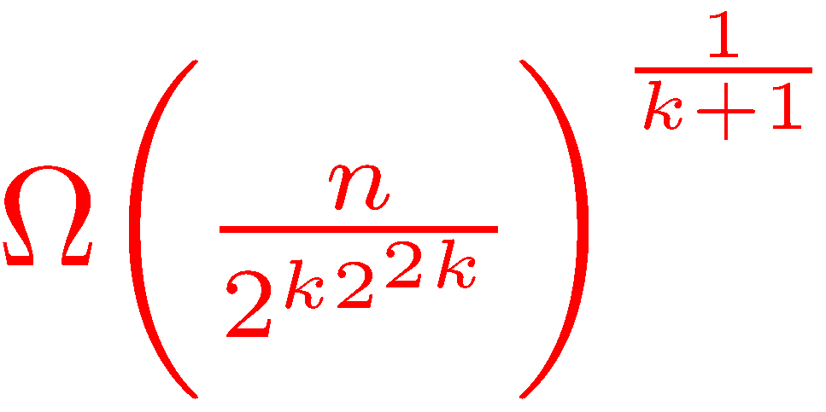
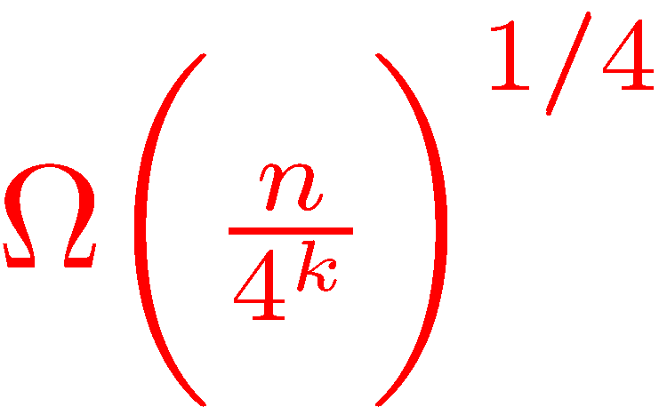
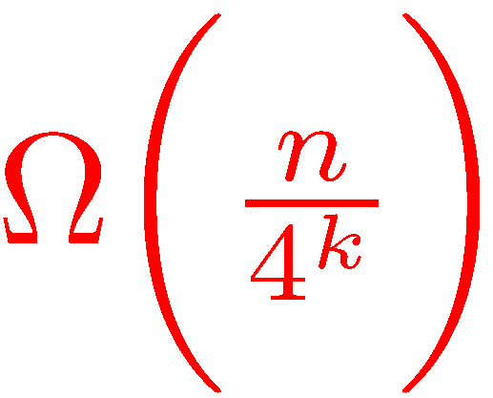
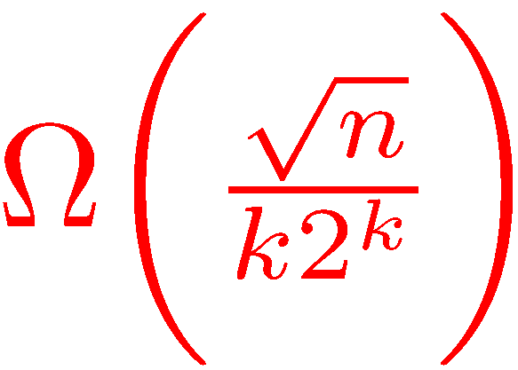
NOF Lower Bounds
k ¸ 3
Popular Names
Deterministic/Randomized
PARITY ± AND
´ GIP
Ω (n/4^{k}).
Babai-Nisan-Szegedy’89
Seminal Paper
NOR ± AND
´ Set-Disj
Ω ((log n)/k).
Tesson’05
Lee-Shraibman’08, C-Ada’08
Apology: SKIPPED other attempts
Improvement
Beame-Huynh-Ngoc’09
Deterministic
Sherstov’12
Sherstov’13
Rao-Yehudayoff’14
TexPoint fonts used in EMF. Read the TexPoint manual before you delete this box.: AAAAAAA

Slide 26
NOF Lower Bounds
k ¸ 3
Popular Names
Deterministic/Randomized
PARITY ± AND
´ GIP
Ω (n/4^{k}).
Babai-Nisan-Szegedy’89
Seminal Paper
Remark 1: There is no separate, easier argument for deterministic case.
Remark 2: All strong bounds on (interactive) k-complexity use variations of the
BNS argument.
Remark 3: All known bounds decay exponentially in k, are trivial for k= !(log n).
Remark 4: By contrast, for k=2 several methods are known.
Discrepancy
Corruption
Fourier-analytic
Information
Theory
Chor-Goldreich’85
Razborov’89
Raz’95
BJKS’02 and many more
TexPoint fonts used in EMF. Read the TexPoint manual before you delete this box.: AAAAAAA

Slide 27
Surprising Upper Bounds
k ¸ 3
Popular Names
Deterministic
Ο (n/2^{k} + k¢ log n ).
SYM ± AND
{GIP, Disj,…}
Grolmusz’91, Pudlak
Almost- Simultaneous
SYM ± g
{GIP, MAJ ± MAJ, Disj…}
O(k.(log n)²), k ¸ log n + 2.
g: compressible
Babai-Gal-Kimmel-Lokam’
Simultaneous
O(k.(log n)²), k ¸ log n + 4.
SYM ± ANY
Ada-C-Fawzi-Nguyen’12
Simultaneous
poly-log(n), k ¸ 2log n
SYM ± ANY_{s}
C-Saks’14
s ¼ log log n
Almost- Simultaneous
TexPoint fonts used in EMF. Read the TexPoint manual before you delete this box.: AAAAAAA

Slide 28
Cylinder Intersections
Rectangles , i.e. C₁(X) £ C₂(Y) £ C₃(Z), are very special.
C_{Z} ´ C_{Z}(X,Y)
Y
C_{Y} ´ C_{Y}(X,Z)
C_{X} ´ C_{X}(Y,Z)
Z
X
C= C_{X} Å C_{Y} Å C_{Z} is a cylinder intersection.
Fact: A c-bit deterministic protocol partitions inputs into at most 2^{c}
monochromatic cylinder intersections.
TexPoint fonts used in EMF. Read the TexPoint manual before you delete this box.: AAAAAAA

Slide 29
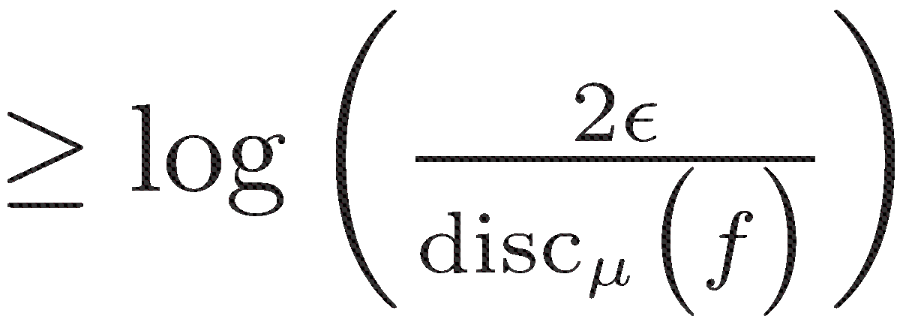

The Discrepancy Method
Discrepancy: For a probability distr ¹,
disc_{¹}(f,C) =
| ¹-wt of f⁻¹(1) in C – ¹-wt of f⁻¹(-1) in C |
disc_{¹}(f) = max_{C}
disc_{¹}(f,C).
¦ ´ C₁ [ C₂ [ ☹ [ C_{t}
Adv in C_{i} = disc_{¹}(f,C_{i})
Total Adv = 2²
Union bound
Discrepancy Method:
Yao’s
method
TexPoint fonts used in EMF. Read the TexPoint manual before you delete this box.: AAAAAAA

Slide 30
Question: How do we compute discrepancy?
An inductive Cauchy-Schwarz argument.
TexPoint fonts used in EMF. Read the TexPoint manual before you delete this box.: AAAAAAA

Slide 31
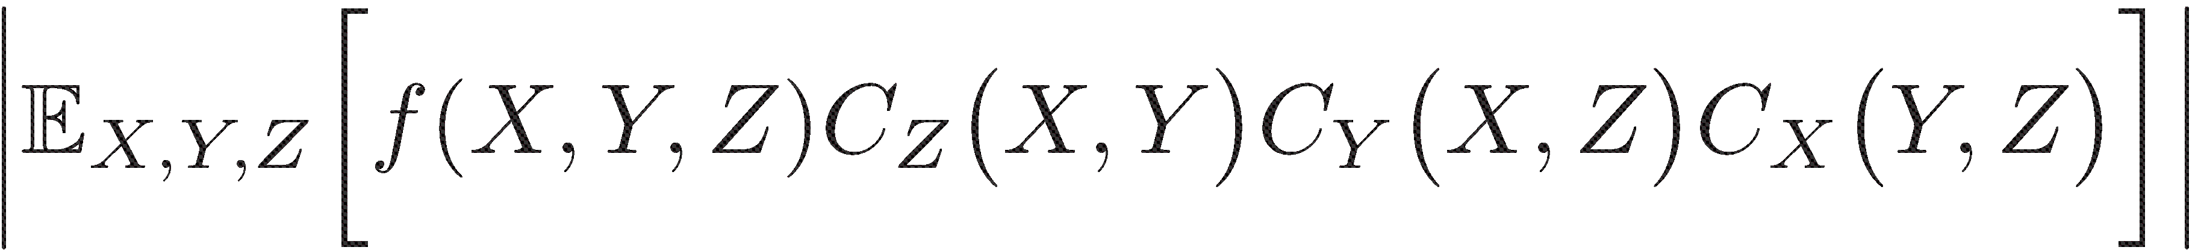

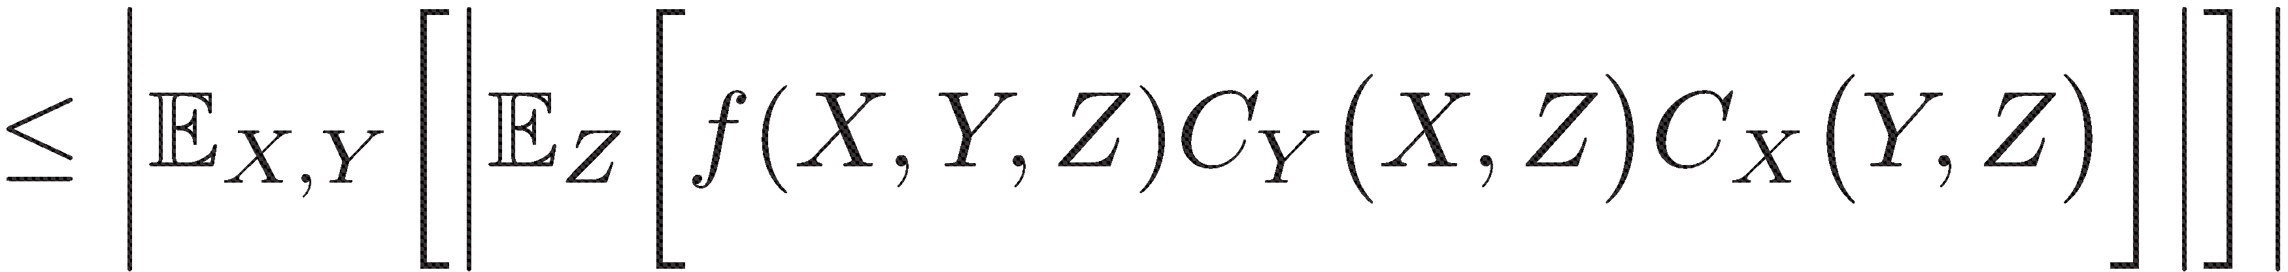
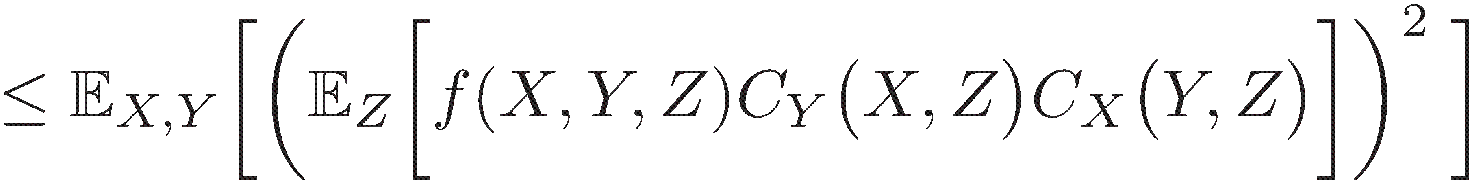
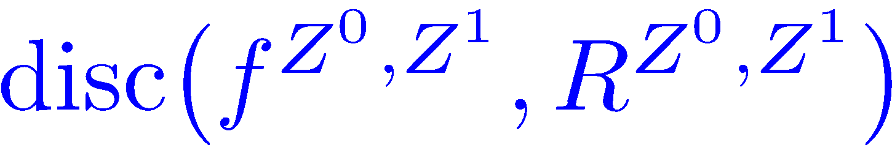
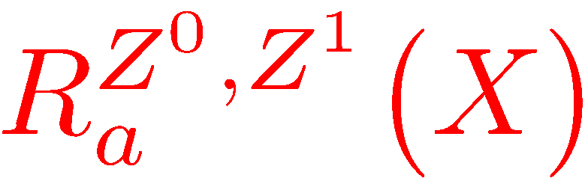
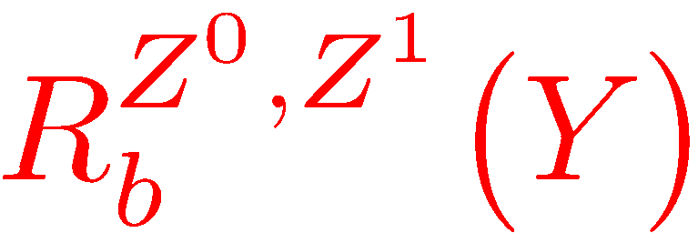
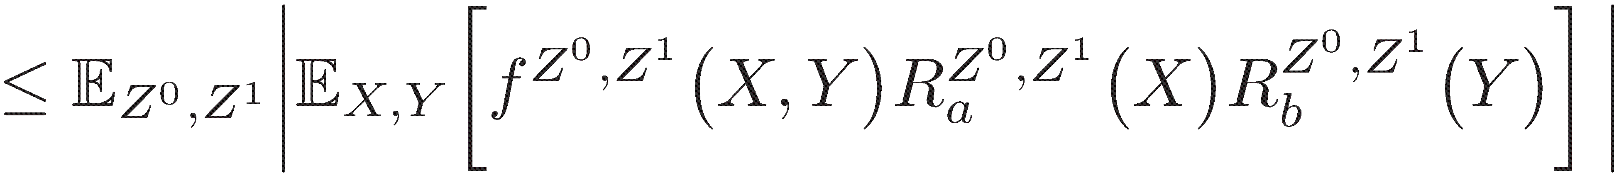
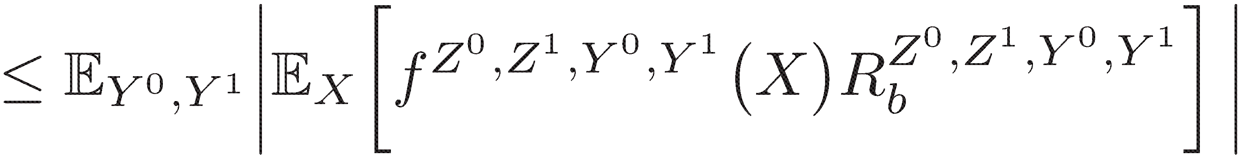
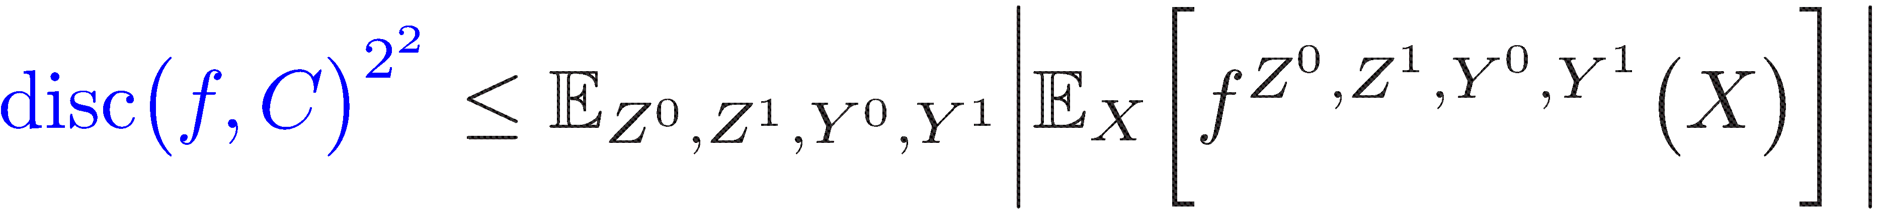
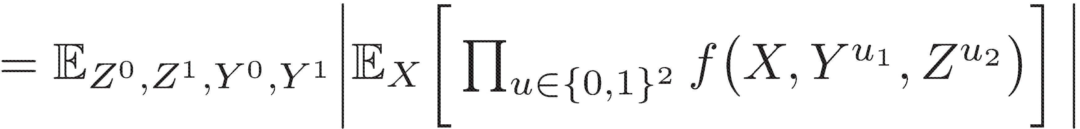
Cauchy-Schwarz Magic
2
2
£2
£2
2
£2
0/1 valued
Cauchy-Schwarz
2
2
2
ind of X
TexPoint fonts used in EMF. Read the TexPoint manual before you delete this box.: AAAAAAA

Slide 32
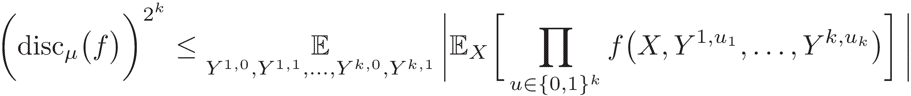
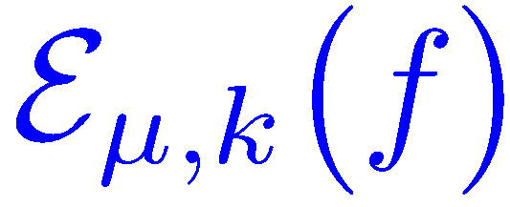
The BNS-Chung Criterion
Theorem (Raz’00):
Cube Measure/Gower’s norm
TexPoint fonts used in EMF. Read the TexPoint manual before you delete this box.: AAAAAAA

Slide 33
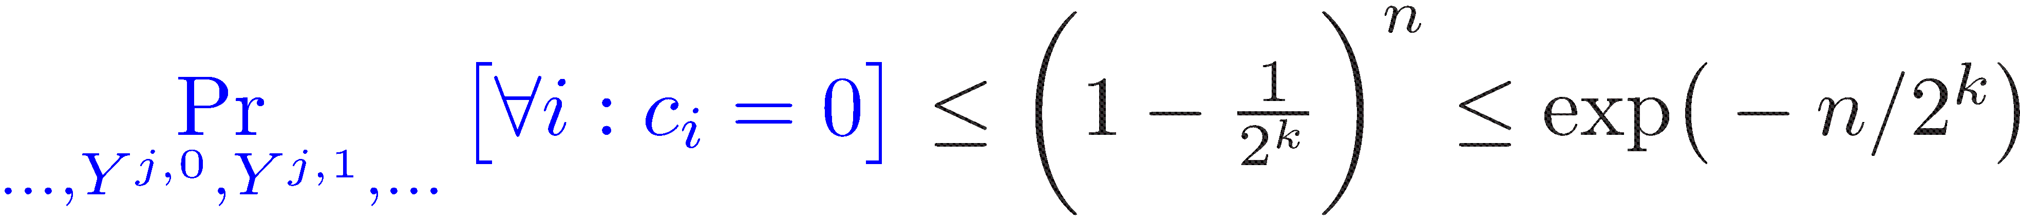

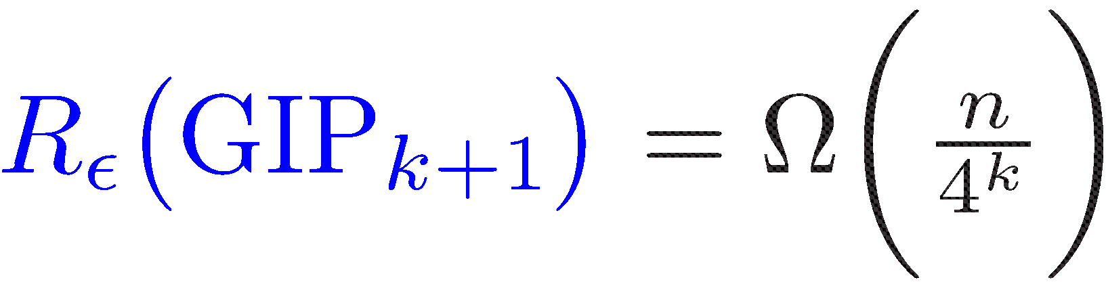
Application to GIP
c_{i}
Observation:
Conclusion:
Discrepancy Method:
TexPoint fonts used in EMF. Read the TexPoint manual before you delete this box.: AAAAAAA

Slide 34
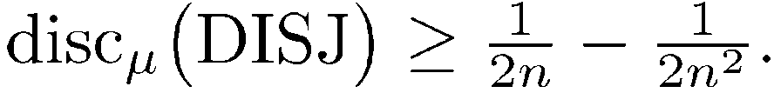
Limitations of Discrepancy
L⁻ = set of non-disjoint inputs
L⁺ = set of disjoint inputs.
C_{i} = set of inputs that have an
all-one ith column
Fact: L⁻ = C₁ [ ☹ [ C_{n.}
Fact: Each C_{i} is a rectangle.
ith column
Conclusion 1: L⁻ has a small cover.
. | . | . | . | . | .
. | . | . | . | . | .
. | . | . | . | . | .
. | . | . | . |  | .
. | . | . | . |  | .
1
Conclusion 2: For every distribution ¹,
1
1
1
1
Corollary: Impossible to get !(log n) bounds for DISJ by direct DM.
TexPoint fonts used in EMF. Read the TexPoint manual before you delete this box.: AAAAAAA

Slide 35
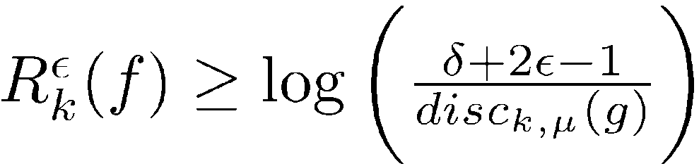
Generalized Discrepancy
Lemma (Generalized Discrepancy): Denote X = Y₁ £ ☹ £ Y_{k}. Let f: X → {1,-1} and g: X → {1,-1} be such that Corr_{¹} (f,g) ¸ ±, for some distribution ¹.
disc(g) << disc(f)
Remark: The classical discrepancy method follows by putting g=f and hence ±=1.
Klauck’01 applied to f = MAJ ± AND.
TexPoint fonts used in EMF. Read the TexPoint manual before you delete this box.: AAAAAAA

Slide 36
Composed Functions
Question: Given f, how to find g?
Answer: No general technique known.
For f ± q, Sherstov’08 and Shi-Zhu’08 gave techniques for 2-party.
TexPoint fonts used in EMF. Read the TexPoint manual before you delete this box.: AAAAAAA

Slide 37
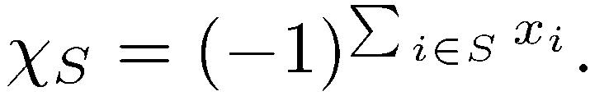
Polynomial Representation
Let V ´ {f | f:{0,1}^{n} → R}.
Observation: V is a vector space of dimension 2^{n}.
Defn: For each S µ {1,☹,n},
Fact: The set M ´ {Â_{S} | S µ[{1,☹,n} forms a basis of V, called the Fourier basis.
Definition: Let f= ∑_{S} c_{S} Â_{S}. The degree of f is the cardinality of a maximal S such that c_{S} ≠ 0.
TexPoint fonts used in EMF.
Read the TexPoint manual before you delete this box.: AAAAAAA

Slide 38
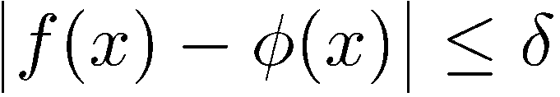
Approximation of Functions
Fundamental: How closely can f:{0, 1}^{n} ! R be approximated by low degree functions?
Definition: The ±-approximate degree of f, deg±(f), is the minimum integer d such that there exists Á 2 span({Â_{S} : |S| · d}) and
max
x2{0,1}^{n}
TexPoint fonts used in EMF.
Read the TexPoint manual before you delete this box.: AAAAAAA

Slide 39
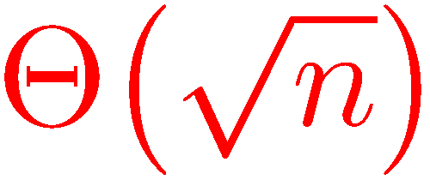
Degree of Functions
AND(X) = X₁ X₂☹ X_{n}
OR(X) = 1 – (1-X₁)(1-X₂)☹(1-X_{n})
PARITY(X)
MAJORITY(X)
Exact degree £(n)
Approx degree?
Fact (Nisan-Szegedy’92): Deg_{1/3}(OR) =
TexPoint fonts used in EMF.
Read the TexPoint manual before you delete this box.: AAAAAAA

Slide 40
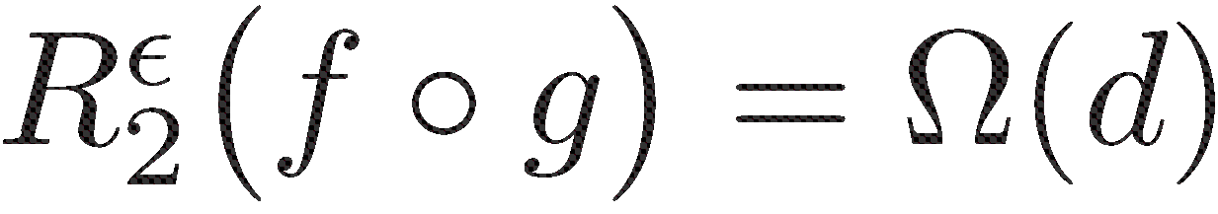
Pattern Matrix Method
X
1 | 0
X₁
X₂
X₁
2
IN :
Y
2
0 | 1
X₁
X₂
X₂
Let f have high approximation degree d.
Let q:{0,1}^{s}£{0,1}^{s} → {0,1} have IN as a sub-(partial)function.
For f ± q, Sherstov’08 applied Generalized-Discrepancy :
TexPoint fonts used in EMF. Read the TexPoint manual before you delete this box.: AAAAAAA

Slide 41
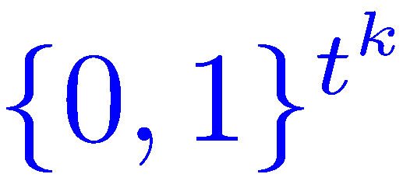



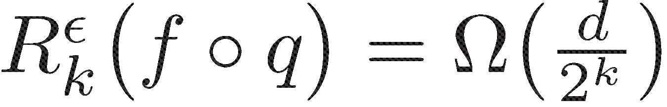

Pattern Tensor Method
Indices into tensor
f : {0,1}^{m} → {0,1}, approximation degree d.
q: {0,1}^{sk} → {0,1}, contains .
Lee-Shraibman’08 and C-Ada’08 applied Generalized-Discrepancy :
constant k, n^{Ω(1)}
doubly exp in k
TexPoint fonts used in EMF. Read the TexPoint manual before you delete this box.: AAAAAAA

Slide 42
Block-Composition
Introduced by Shi-Zhu’08 for 2-party.
f : {0,1}^{m} → {0,1}, approximation degree d.
same property
as before
q : {0,1}^{s}£{0,1}^{s} → {0,1}.
spectral (analytic) property
f ± q: Generalized-Discrepancy gives strong 2-party bounds.
How to extend to k ¸ 3 parties?
TexPoint fonts used in EMF. Read the TexPoint manual before you delete this box.: AAAAAAA

Slide 43
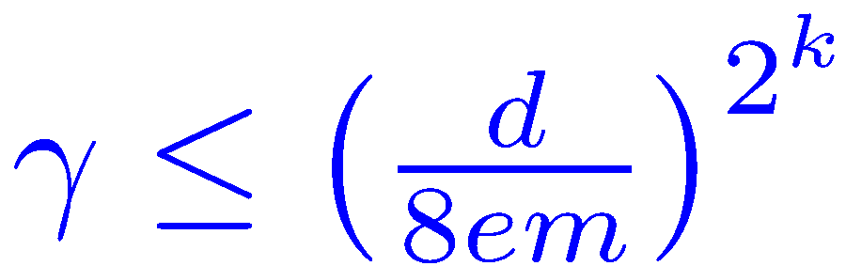


Discrepancy Amplification
q : {0,1}^{(k+1)£t} → {0,1}.
º : q is º-balanced.
Defn: q is (°,º)-amplifiable if for all S µ [m]:
TexPoint fonts used in EMF. Read the TexPoint manual before you delete this box.: AAAAAAA
Theorem(C’08): If ,

Slide 44
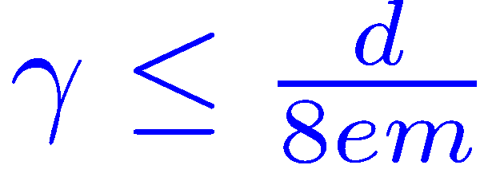
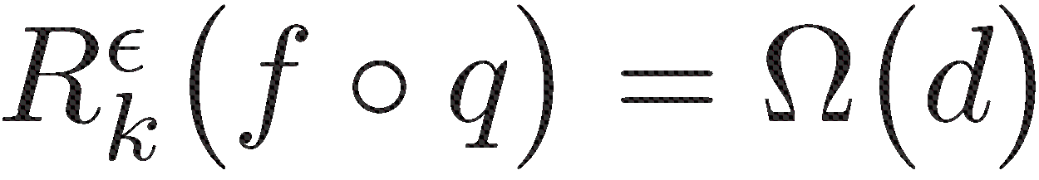
Multiparty Block Composition
f : {0,1}^{m} → {0,1}, approximation degree d.
same property
as before
q : {0,1}^{(k+1)£s} → {0,1}.
q is º-balanced and (°,º)-amplifiable
Theorem(C’08): If ,
TexPoint fonts used in EMF. Read the TexPoint manual before you delete this box.: AAAAAAA

Slide 45
Proof
Approximation-Orthogonality
Simple Fourier Analysis
TexPoint fonts used in EMF.
Read the TexPoint manual before you delete this box.: AAAAAAA

Slide 46
Approximation-Orthogonality
Lemma (Sherstov08, Shi-Zhu08): Let f:{0,1}^{m} ! {-1, 1} have deg±(f) = d ¸ 1. Then, there exists a g:{0,1}^{m} ! {-1,1} and a distribution ¹ such that
and g is (¹,d)-orthogonal, i.e.
TexPoint fonts used in EMF.
Read the TexPoint manual before you delete this box.: AAAAAAA

Slide 47

Block Communication Strategy
Approx-degree= d
f±q
Fact (NS’92): Deg_{1/3}(OR) = Ω( ).
f
block q
(¹,±)-
Correlated
(¸,±)-
Correlated
disc¸(g±q)
is low.
g
g±q
(¹,d)-
orthogonal
block q
Hardness-Amplification
Lemma
Discrepancy-Method
Approximation/Orthogonality
Lemma
R_{k}²(f±q) is high
R_{k}²(g±q) is high
TexPoint fonts used in EMF.
Read the TexPoint manual before you delete this box.: AAAAAAA

Slide 48
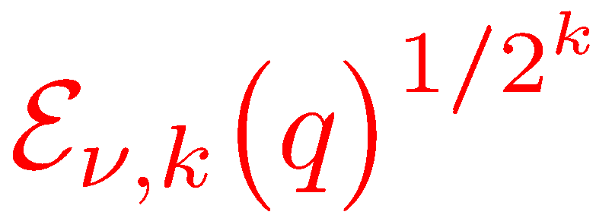

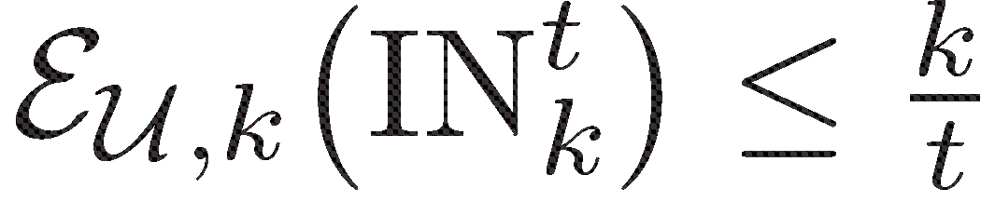
The Inner Function
Question: How do we find such nice q?
Try bounding
Theorem (C’08):
Theorem (C’08):
TexPoint fonts used in EMF.
Read the TexPoint manual before you delete this box.: AAAAAAA

Slide 49
Two-Party Communication
TexPoint fonts used in EMF.
Read the TexPoint manual before you delete this box.: AAAAAAA

Slide 50
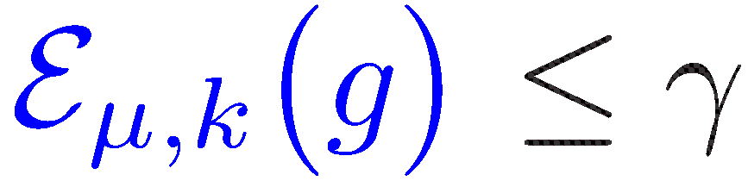
Multiparty Block Composition
f : {0,1}^{m} → {0,1}, approximation degree d.
same property
as before
g : {0,1}^{k£s} → {0,1}.
small cube-measure
g is ¹-balanced
Theorem(C’08): If ,
TexPoint fonts used in EMF. Read the TexPoint manual before you delete this box.: AAAAAAA

Slide 51
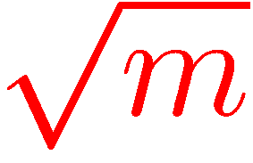
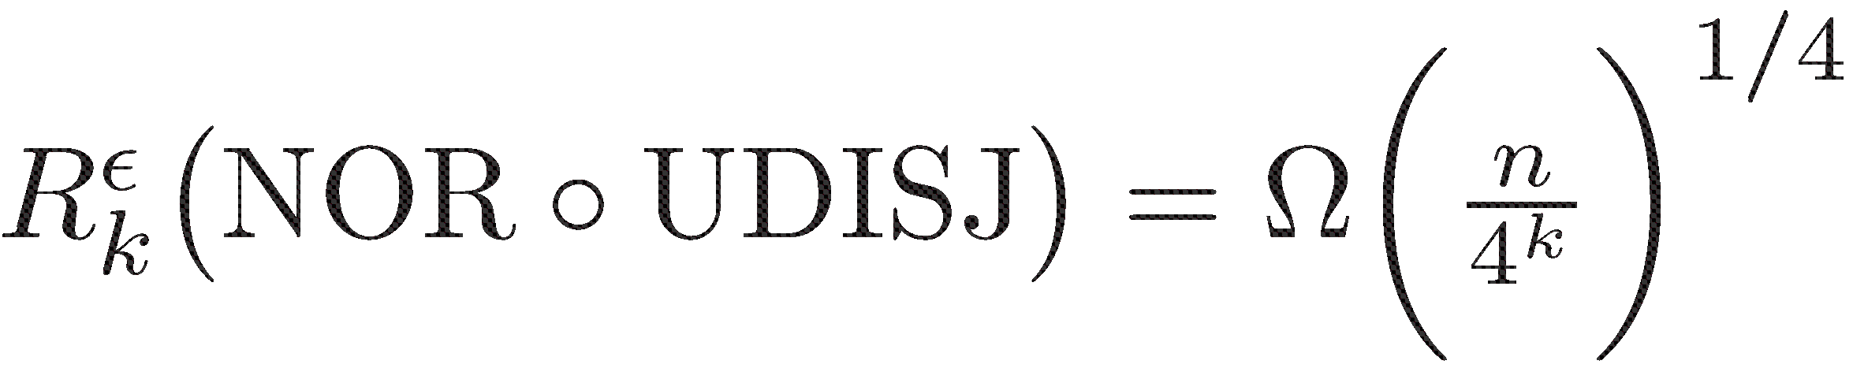
Disjointness as Inner Function
NOR : {0,1}^{m} → {0,1}, approximation degree d = .
UDISJ_{s} : {0,1}^{(k+1)£s} → {0,1}.
¹_{k,s} : uniform distrbn on k £ s matrices with exactly one all-1 column
U_{s} : uniform distrbn on {0,1}^{s}
 |  | . |  | .
0 | . | . | 1 | . | .
. | . | . | 1 | . | 0
. | 0 | . | 1 | 0 | .
. | . | 0 | 1 | . | .
U_{s}
x₁
x₂
x_{i}
x_{s}
¸_{k,s} : U_{s} £ ¹_{k,s}
NON-Prod distrbn
¹_{k,s}
Theorem(Sherstov’12):
n = sm
TexPoint fonts used in EMF. Read the TexPoint manual before you delete this box.: AAAAAAA

Slide 52
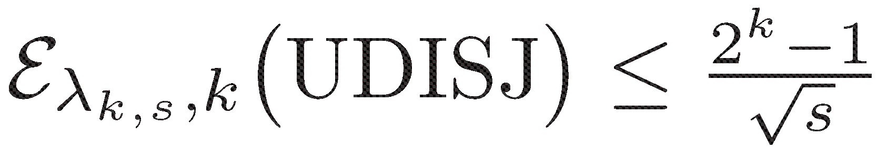
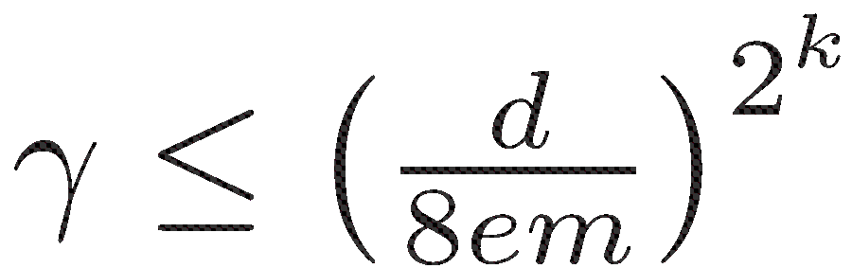

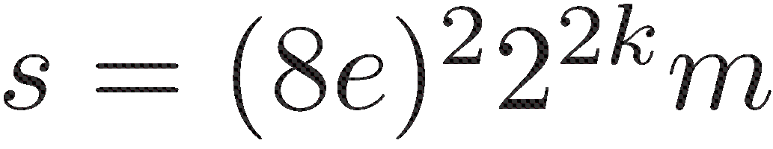
Disjointness as Inner Function
NOR : {0,1}^{m} → {0,1}, approximation degree d = .
UDISJ_{s} : {0,1}^{(k+1)£s} → {0,1}.
¹_{k,s} : uniform distrbn on k £ s boolean matrices with exactly one all-1 column
U_{s} : uniform distrbn on {0,1}^{s}
¸_{k,s} : U_{s} £ ¹_{k,s}
Theorem(Sherstov’12):
= °
Goal:
C’08
n = sm
TexPoint fonts used in EMF. Read the TexPoint manual before you delete this box.: AAAAAAA

Slide 53
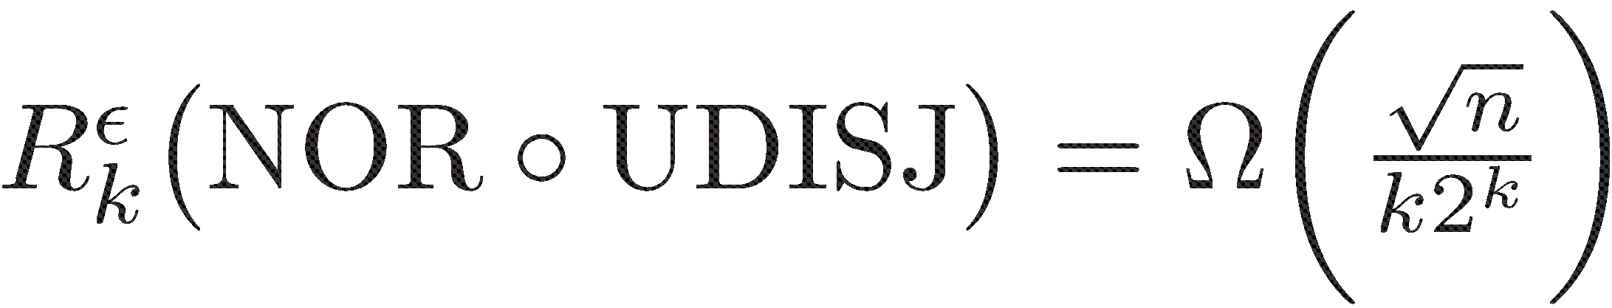
Recent Breakthrough
Theorem(Sherstov’13): Using more analytic technique:
Rao-Yehudayoff’14: Simplify above. Show further
Tight!
TexPoint fonts used in EMF. Read the TexPoint manual before you delete this box.: AAAAAAA

Slide 54
Conclusion
Did not cover MANY developments.
Several open directions to pursue.
Thanks!
TexPoint fonts used in EMF. Read the TexPoint manual before you delete this box.: AAAAAAA

